Slide 1
PRODUCT PRESENTATION ARCOMA PRECISION i5

Slide 2
CONTENT
About Arcoma
The Arcoma Precision i5
The wall stand
The OTC
The table
The detectors
The accessories

Slide 3
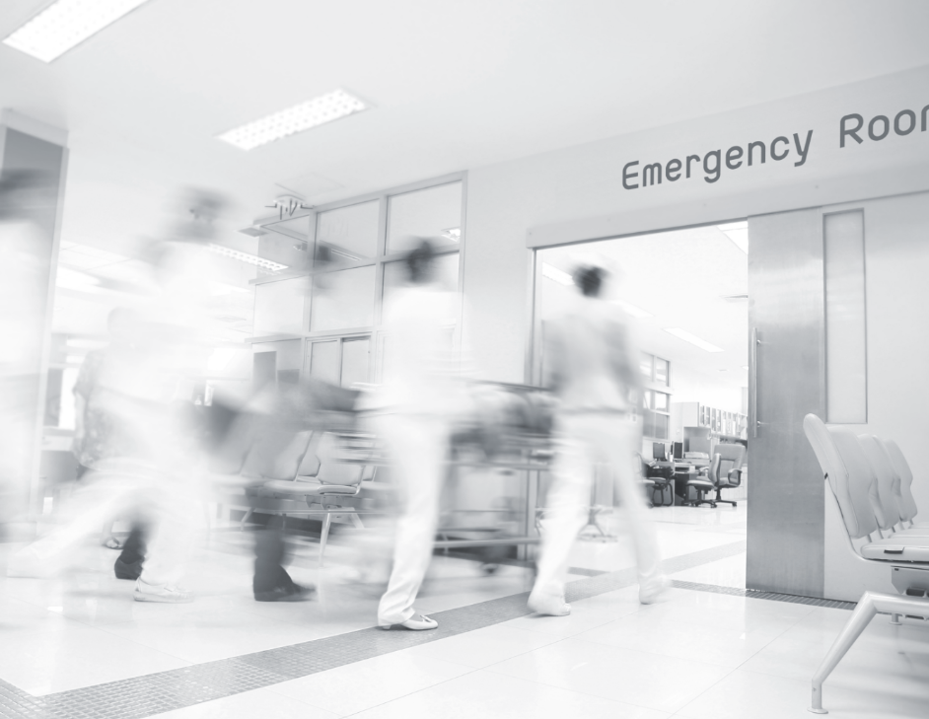
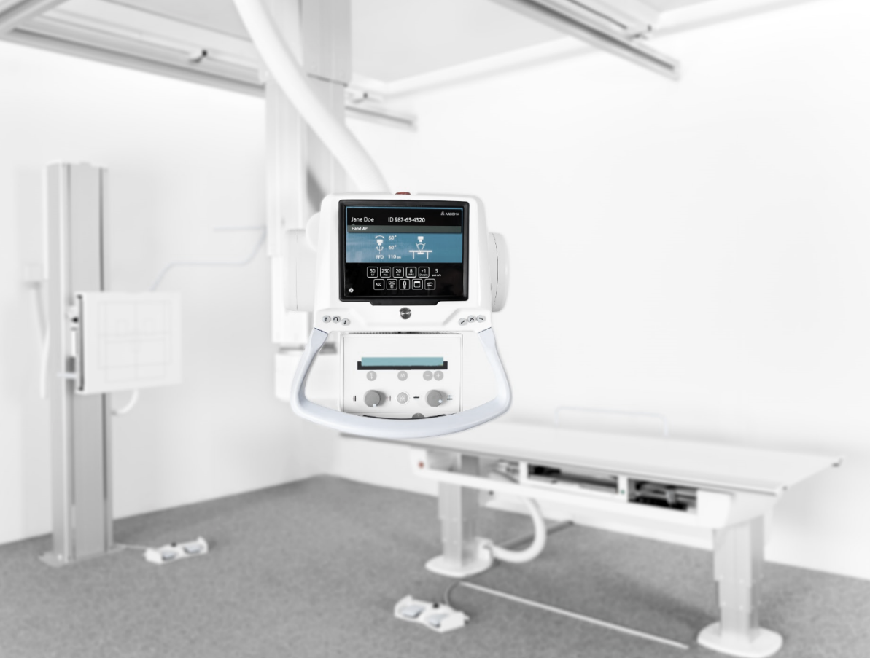
ABOUT ARCOMA
Arcoma develops, produces and provides complete radiology solutions worldwide with the mission to improve care for the patient and the work environment for the user.
Reduce healthcare costs
Improve work environment
Improve patient care

Slide 4
Arcoma offers product solutions covering key clinical applications in the radiology area.
GENERAL CLINIC
MUSCLE/ SKELETON CLINIC
THORACIC CLINIC
PEDIATRIC CLINIC
TRAUMA/
RESUS CLINIC
Notes:
https://www.istockphoto.com/se/foto/patienten-gubbe-h%C3%A5ller-hj%C3%A4rta-f%C3%B6r-hj%C3%A4rtinfarkt-koncept-gm1049772140-280738636
https://www.istockphoto.com/se/foto/sjukgymnaster-anv%C3%A4nder-h%C3%A4nderna-f%C3%B6r-att-greppa-patientens-l%C3%A5r-f%C3%B6r-att-kontrol-lera-gm1147201070-309365276
https://www.istockphoto.com/se/foto/l%C3%A4kare-att-unders%C3%B6ka-patientens-medicinska-journaler-gm902231646-248883193

Slide 5
SUPERIOR WORKFLOW
OUR PRODUCTS ENABLE
UNIQUE
RELIABILITY
EXCELLENT DIAGNOSTIC RESULTS
Notes:
Brilliant
Impressive
Terrific
Fantastic
Significant
Unique

Slide 6
ARCOMA PRECISION i5

Slide 7
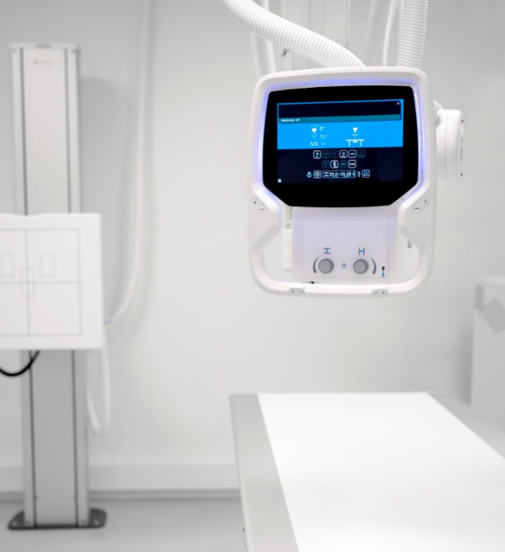
OUR PRODUCT LINES
ARCOMA PRECISION i5
PREMIUM DIGITAL X-RAY SYSTEM
Arcoma Precision i5 is a new premium digital X-ray system that provides high quality images, clinical flexibility and superior workflow.
This is one of the most reliable products on the market, designed and built in Sweden according to the highest quality standards.
The workflow is excellent thanks to state-of-the-art ergonomics and supporting features such as auto positioning, wall stand with motorized tilt and automatic detector tracking.
The manual fine-tuning of the overhead tube crane is unique and can be made with minimal force. Also the ultralight and flexible Canon detectors ensures excellent imaging result at all times with minimal dose.
Notes:
To change the image behind the Mock up.
Select the layer - > Right Click -> Send to Back -> Delete the image -> Drag & Drop your Own Picture -> Send to Back (again)

Slide 8
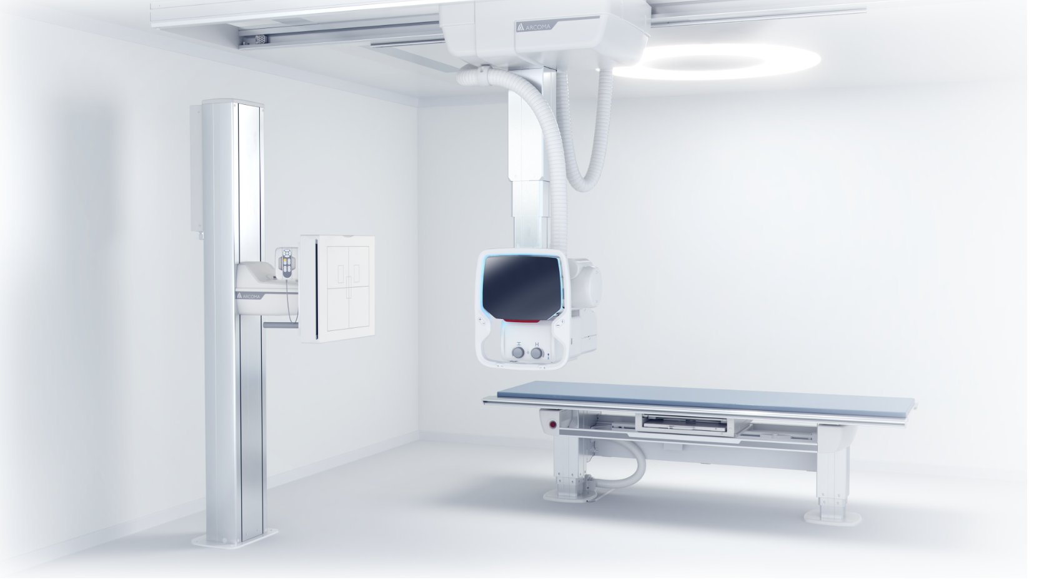
Low dose
Flexible detector configurations
Excellent imaging result
Safe investment
Superior workflow
ARCOMA PRECISION i5
Superior ergonomics
PREMIUM DIGITAL X-RAY SYSTEM
Notes:
The most important benefits of the precision i5.

Slide 9
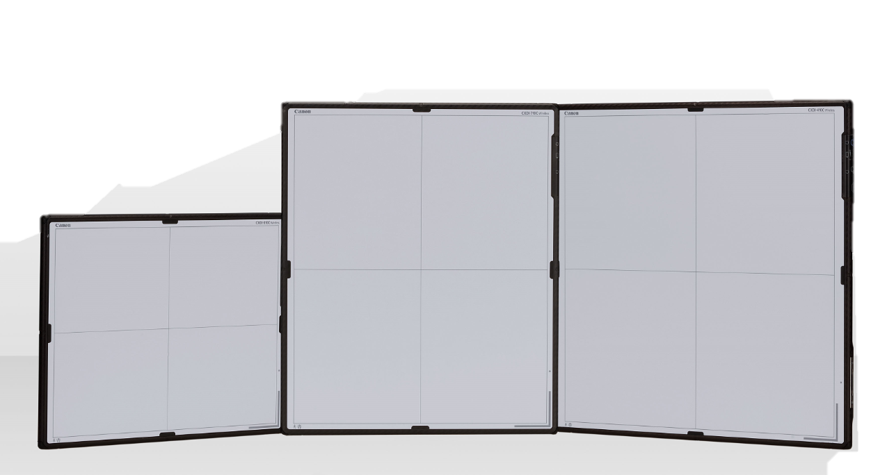
SUPERIOR WORKFLOW
AUTO POSITIONING
EASY-TO-USE INTERFACE
Fully motorized auto-positioning when anatomical protocol selected.
Easy-to-use interface with preview image shown in approximately / ~ 1 second *1).
EXCELLENT FINE-TUNING
MOTORIZED & MANUAL WALL STAND
Fine tuning into the right position is done manually, with minimal force needed.
Easy upward, downward and tilt of the detector from the control panel or foot control (optional) with the OTC tracking.
AUTOMATIC DETECTOR TRACKING
WIRELESS DETECTORS
The tube automatically tracks the position of the detector so that the user can focus on the patient.
Ultralight, flexible and wireless detectors.
*1) Depending on acquisition mode
Notes:
Easy to use interface
Quick start-up
Auto positioning
Excellent fine tuning
Easy access for patients
Easy stitching

Slide 10
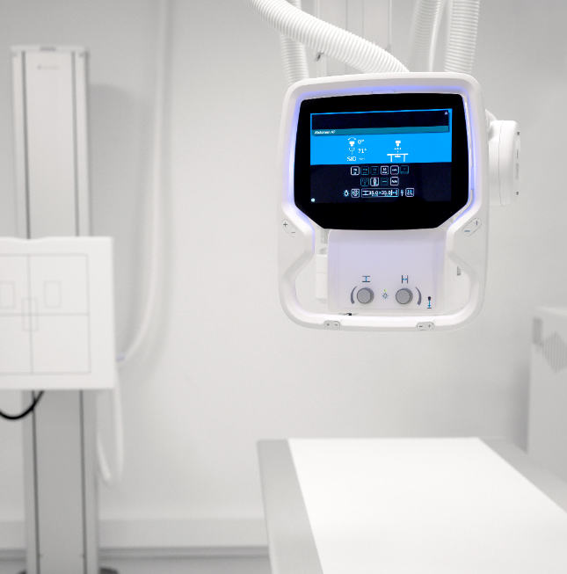
SAFE INVESTMENT
Arcoma Precision i5 is designed for the productivity and versatility needs of high-volume hospital imaging departments.
Its robust construction and high quality helps ensure reliable operation, minimal service and a long product lifespan, all of which lowers the lifetime cost.
Reliable operation
Minimal service needs
Long product lifespan
Low lifetime cost
Notes:
Very reliable operation
Support and service
Long life time
Low life time cost

Slide 11
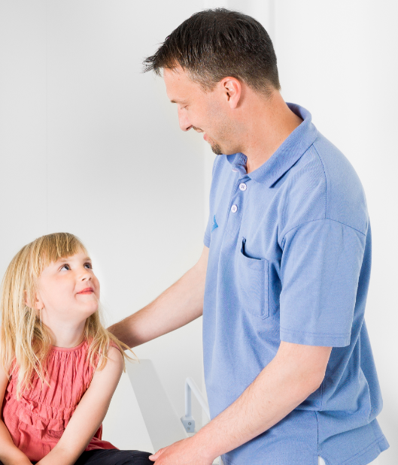
LOW DOSE
Arcoma Precision i5 provides high quality imaging with low dose for maximum patient safety. Software simulated grid is available as an option. It can be used for patients of all sizes and lower the dose by up to 60%.
Arcoma continuously works to create a lower radiation dose in our solutions. Examples of components in the Arcoma Precision i5 system that contribute to dose reduction:
CANON DETECTORS WITH HIGH DQE
SOFTWARE SIMULATED GRID*
AUTOMATIC EXPOSURE CONTROL
* Scatter correction software (option)
Notes:
Other things that reduces the dose level:
Advanced Image Processing algorithms.
Scatter Correction Software (all anatomies).
Automatic Exposure Control: Consistency + correct dose level.
Grid can be used to reduce noise introduced by scattered radiation. Grid can also easily be removed.
X-ray tube filtration: Can be automatically selected.
Dose Area Product (DAP) monitoring.
Accurate positioning alignment.

Slide 12
Components that contribute to low dose
Arcoma continuously works to create a lower radiation dose in our solutions. The following components in the Arcoma Precision i5 system contribute to dose reduction:
CANON DETECTORS WITH HIGH DQE
The Canon detectors have high DQE (detective quantum efficiency), which provides a more efficient use of radiation, (i.e. low dosage) and high quality images.
SOFTWARE SIMULATED GRID
Dose can be reduced by up to 60% using a virtual grid (optional scatter correction software) for bedside examinations, rather than a physical grid.
DOSE MONITORING
The system is equipped with a Dose Area Meter (optional) that will measure and transfer the patient dose.
AUTOMATIC EXPOSURE CONTROL
Automatic exposure control automatically sets the exposure parameters for a specific patient and ensures good image quality with minimal dose.
PREDEFINED PROTOCOLS
Predefined protocols for different patient sizes can easily be selected from the tube display to adapt the dose accordingly.
ADVANCED IMAGING PROCESSING ALGORITHMS
Notes:
Other things that reduces the dose level:
Advanced Image Processing algorithms.
Scatter Correction Software (all anatomies).
Automatic Exposure Control: Consistency + correct dose level.
Grid can be used to reduce noise introduced by scattered radiation. Grid can also easily be removed.
X-ray tube filtration: Can be automatically selected.
Dose Area Product (DAP) monitoring.
Accurate positioning alignment.

Slide 13
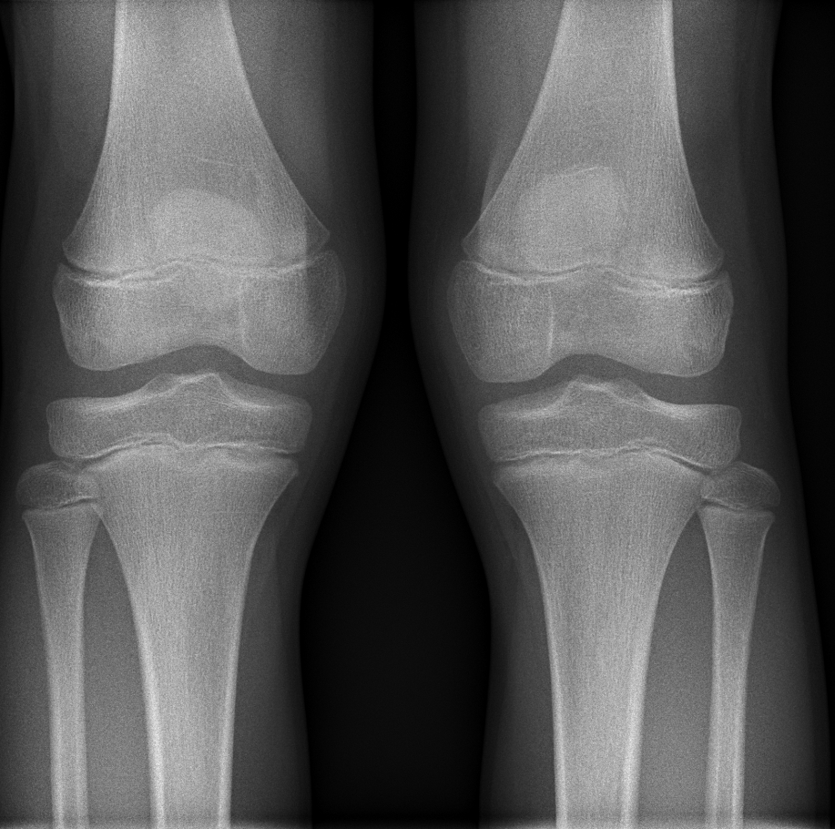
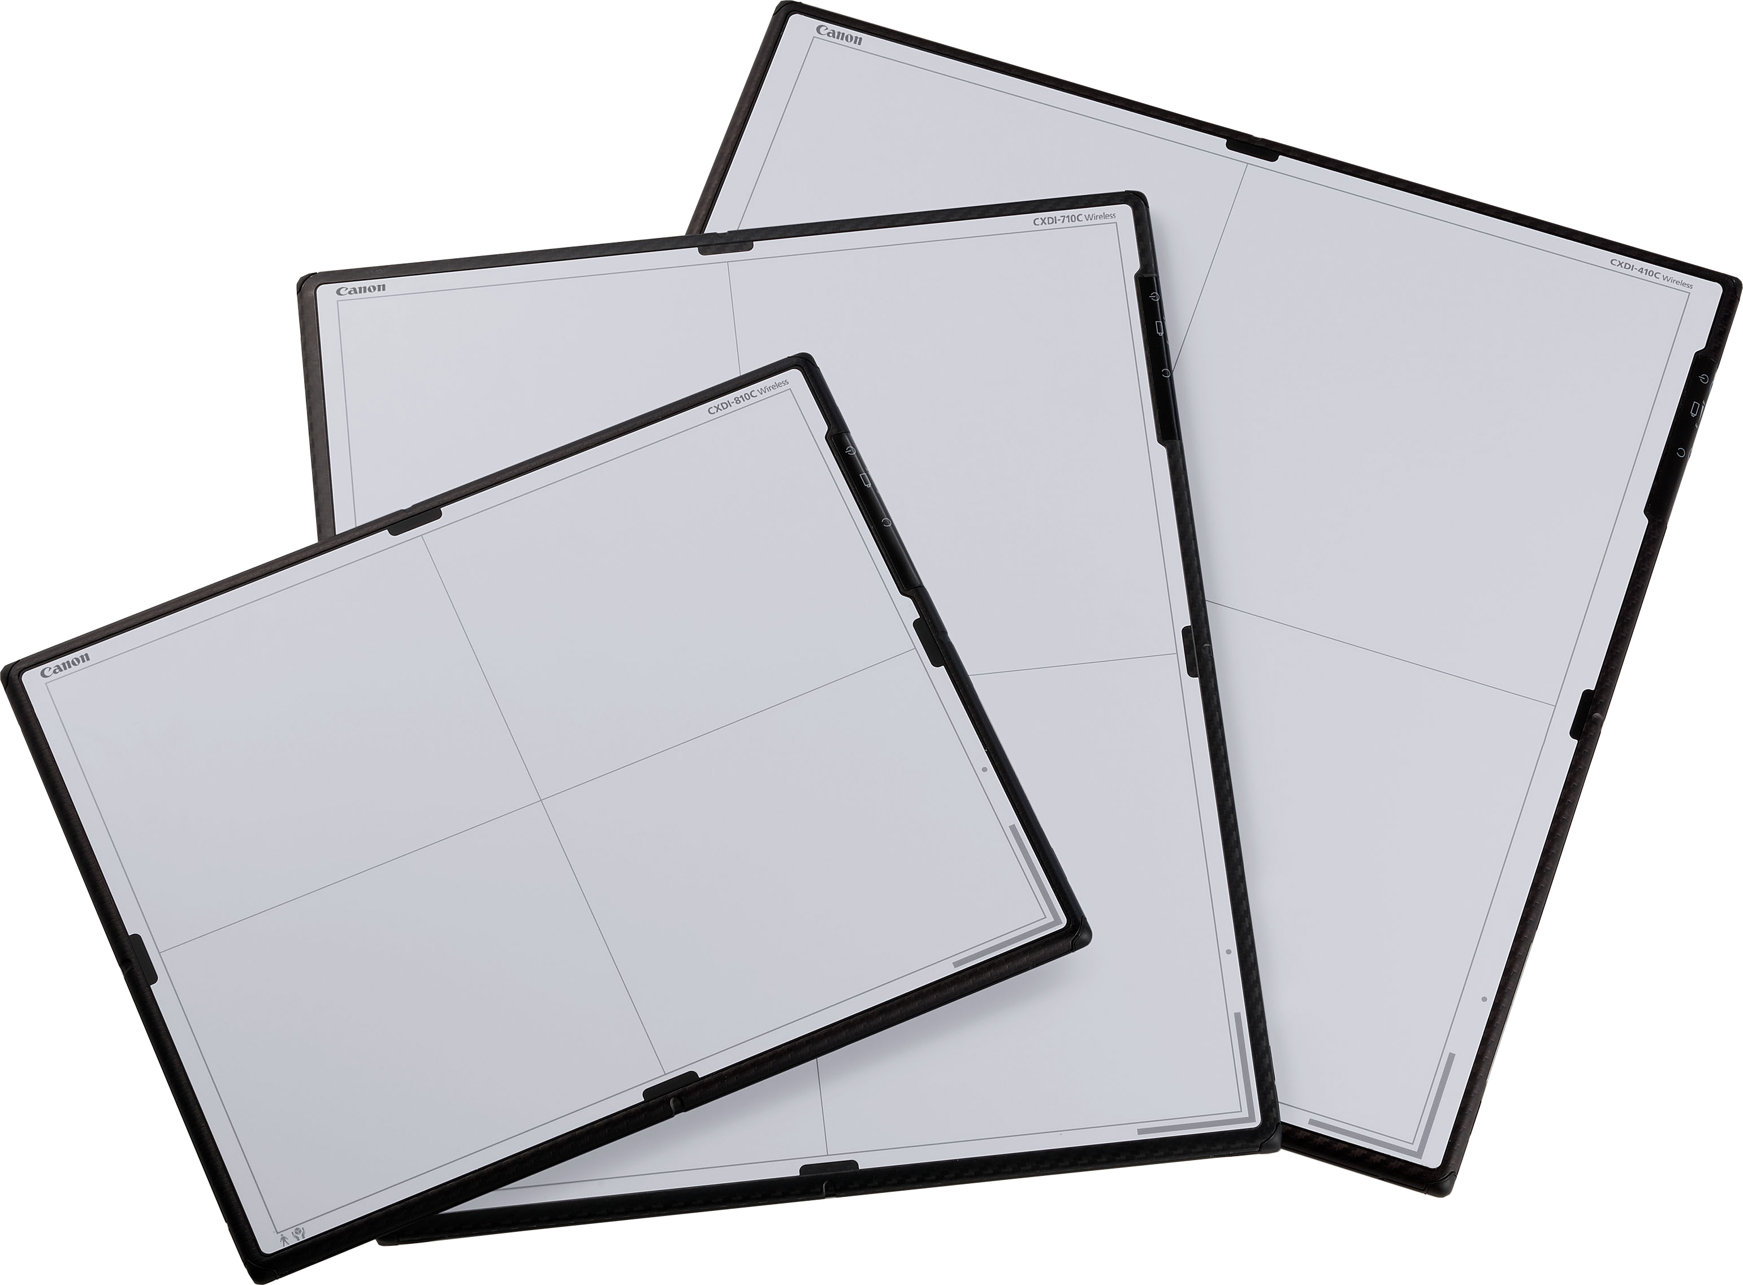
EXCELLENT IMAGING RESULT
Arcoma Precision i5 is powered by Canon’s next generation wireless CXDI detectors and imaging software.
Canon´s CXDI-NE software provides a GUI* that is always right for you. Comprehensive image processing, including software simulated grid, guarantees optimal image quality and minimal dose.
* GUI = graphical user interface
Notes:
Fast and efficient positioning is one of the most important things for a radiologist.
Arcoma Precision enables easy and quick positioning thanks to auto positioning, automatic detector tracking and motorized wall stand.

Slide 14
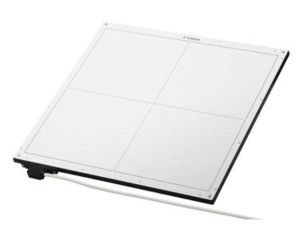
FLEXIBLE DETECTOR CONFIGURATIONS
The ultra lightweight, waterproof detectors (IP 57) with integrated battery and image storage can be used on board or stand-alone.
Up to 4 detectors can be used with Precision i5 to provide optimal positioning and imaging flexibility. The detectors can also be:
shared between x-ray rooms
used for mobile X-ray solutions
used in the holder or wireless
The table and wall stand can be equipped with charging so that detectors are always ready to use.

Slide 15
SUPERIOR ERGONOMICS
Patient centric care is Arcoma´s approach to everything we design. Our focus is to provide an environment that minimizes stress on staff and maximizes comfort for the patient.
Arcoma Precision i5´s motorized and automatic movements, together with the lightweight OTC and flexible table design, make it an ideal ergonomic solution for both patient and operator.
Motorized movements, smooth and silent
Lightweight OTC, easy fine-tuning
Motorized table, ergonomic working height
Intuitive user interface
Notes:
What samsung says:
State-of-the-art ergonomics
• Designed to minimize stress on staff and maximize patient comfort
• One-touch, stress-free DR with minimum manual handling
• Automatic, smooth, low-noise motorized movements
• SmartHandle with inTouch technology for intuitive manual control & adjustments
• 12” floating touch screen user interface remains horizontal to the user regardless of tube rotation
• Configurable inLight in equipment ceiling dims when the colli-mator light is activated

Slide 16
TECHNICAL SPECIFICATIONS
OTC
Rotation range ceiling (beta): >340°
Rotation range tube arm (alpha): >±135°
Column (Z stroke): 1750 mm
Longitudinal movement (X stroke:) 3190 mm (X-rail 4 000 mm)
Transverse movement (Y stroke): 4160 mm (Y-rail 5 000 mm)
TABLE
WALL STAND
Patient load: 300 kg (660 lbs)
Motorized vertical travel: 555 - 930 mm (22” - 36”)
Longitudinal travel: ± 600 mm (± 23”)
Lateral travel: ± 150 mm (± 6”)
Low central beam height: 27 cm
Motorized wall stand tilt (-20° - +90°)
Vertical stroke: ~1582 mm (1897 mm with tilted detector)
Notes:
Easy to use interface
Quick start-up
Auto positioning
Excellent fine tuning
Easy access for patients
Easy stitching

Slide 17
THE WALL STAND - A DEEPER LOOK

Slide 18
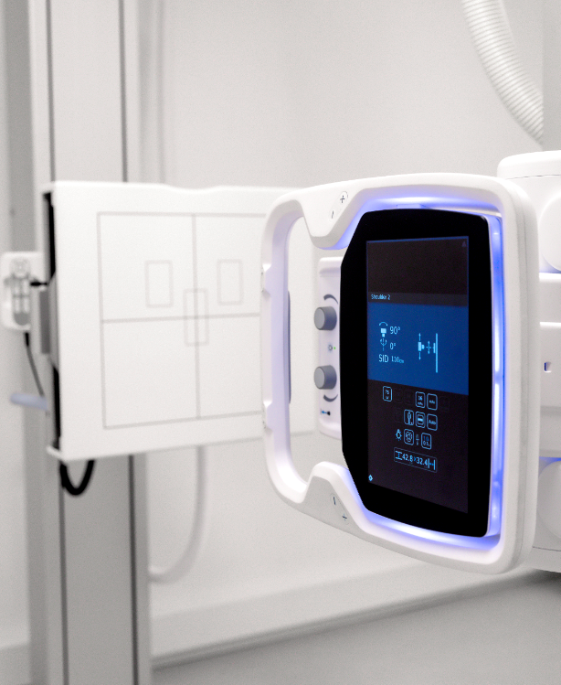
WALL STAND WITH MOTORIZED TILT
OPTIMIZED WORKFLOW
Motorized movements enables efficient examinations
ERGONOMIC DESIGN
Motorized tiltable wall stand allows minimal manual handling.
FULL FOCUS ON THE PATIENT
Easy adjustment and motorized tilt enables increased focus on the patient.
Notes:
Snabbare undersökningar
Effektivare arbetsflöde
Automatiskt pendelmode
Ergonomiskt- tiltad detektor, behöver inte manuellt
Rasterhantering (vill ej lyfta upp än). Kommer när vi uppdaterar bordet.
Tystade än tidigare. Tagit bort fläkten ur systemet. (ny power supply). Phase out.
Business case 4410 – kolla vad linda har skrivit där.
Lättare att ställa in
Ägna mer fokus på patient. Behöver inte höja och sänka detektorvagnen.

Slide 19
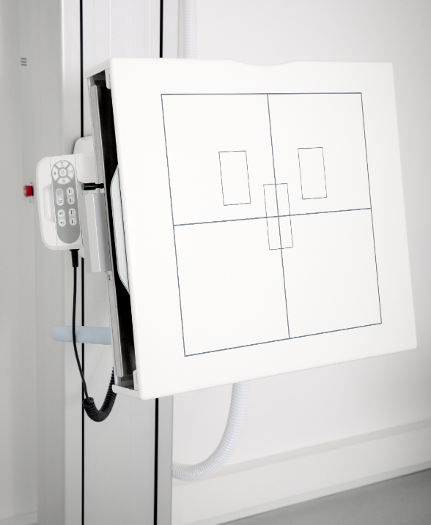
WALL STAND - FEATURES
FEATURES
Motorized tilt of the detector
Motorized and manual vertical movements
Auto tracking (vertical, tilting and pendulum mode)
Hand control for operating wall stand, collimator and auto positioning
Wireless foot controls
Removable lateral arm rest with parking position and adjustable angle
Extended range of vertical movement (Highest and lowest detector position on the market)

Slide 20
WALL STAND ANIMATION

Slide 21
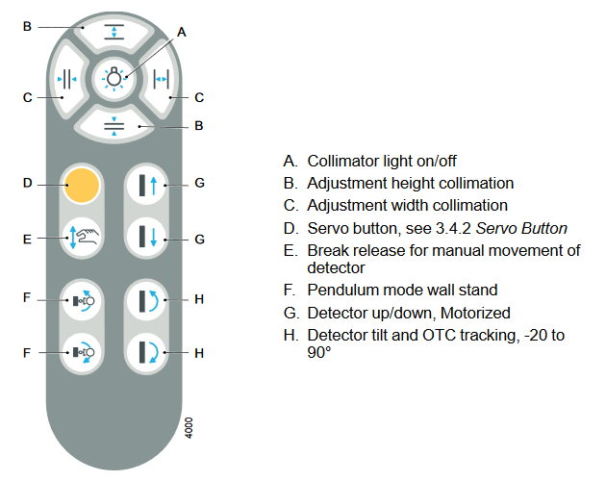
OPERATING THE WALL STAND

Slide 22
THE OVERHEAD TUBE CRANE - A DEEPER LOOK

Slide 23
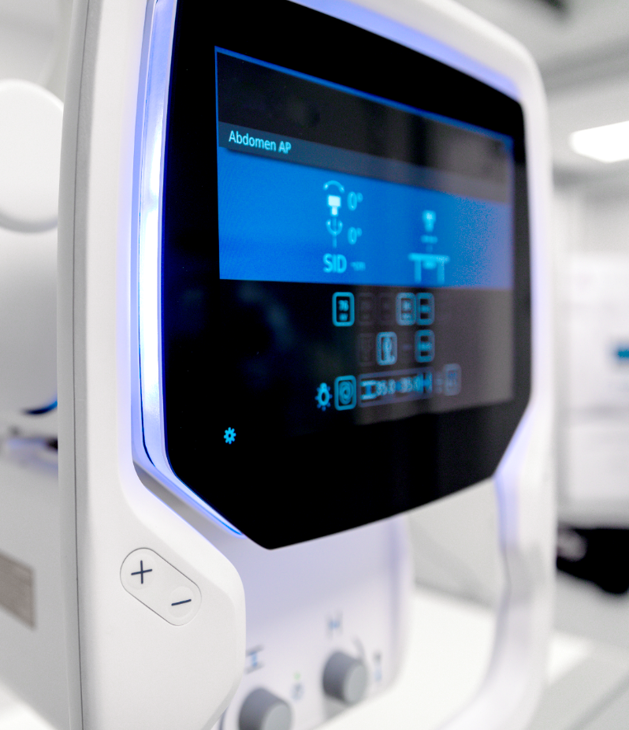
MODERN AND EASY TO USE OTC
EXCELLENT DESIGN
Modern Scandinavian design that blends in nicely into any hospital environment.
EASY DISINFECTION
Easy cleaning and disinfection thanks to glass overlay display with no edges.
SMART AND EASY TO USE Good viewing angle of display and few buttons makes the OTC user-friendly and easy to understand.
Notes:
All system data and configuration on the OTC display (collimator display borttagen och integrerad i OTC)
Improved ergonomics with buttons designed for intuitive use
Backlight ? Vet ej om den kommer att användas för signalering i första release ???
New modern touch display (iPad like interaction) à säg något om det
Bra/bästa betraktningsvinkel av display ???
For later:
Customizable
Possible to customize OTC graphical user interface.
Future SW upgrades will allow personalization and customization of GUI (release schedule not set)

Slide 24
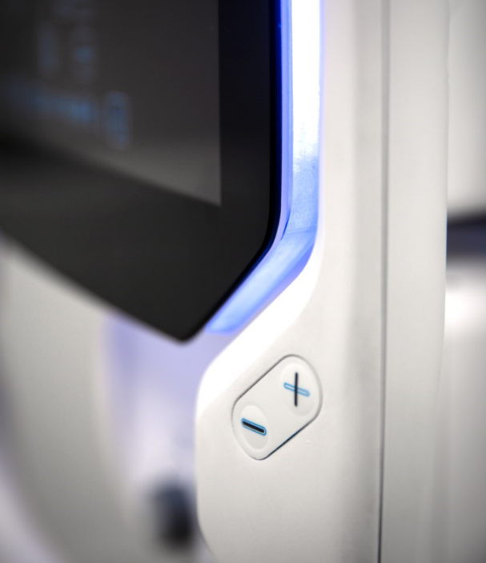
OTC - FEATURES
FEATURES
One of the lightest OTC on the market
Modern user interface
All functions and data in one single workspot
Easy to access buttons
Integrated light indication
All directions movement
Adapted for left- and righthanded
Flexible user interface

Slide 25
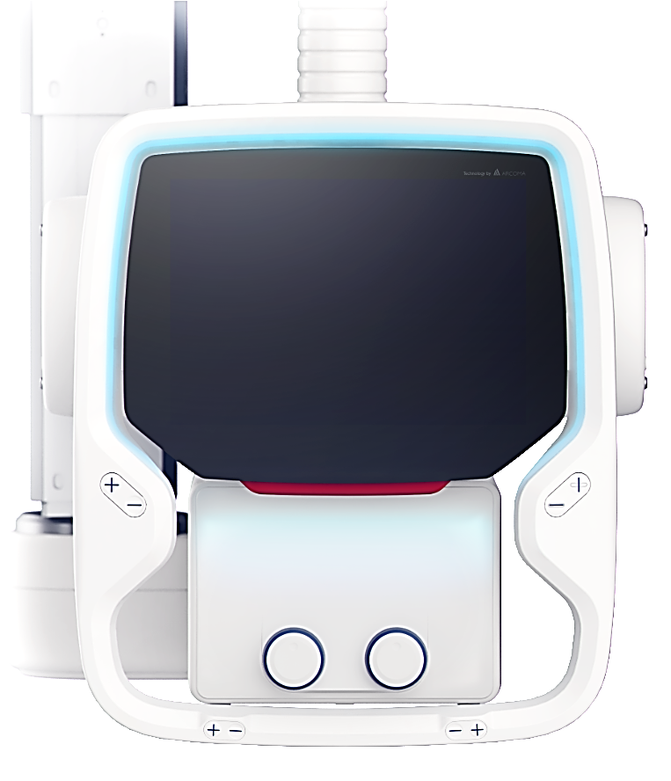
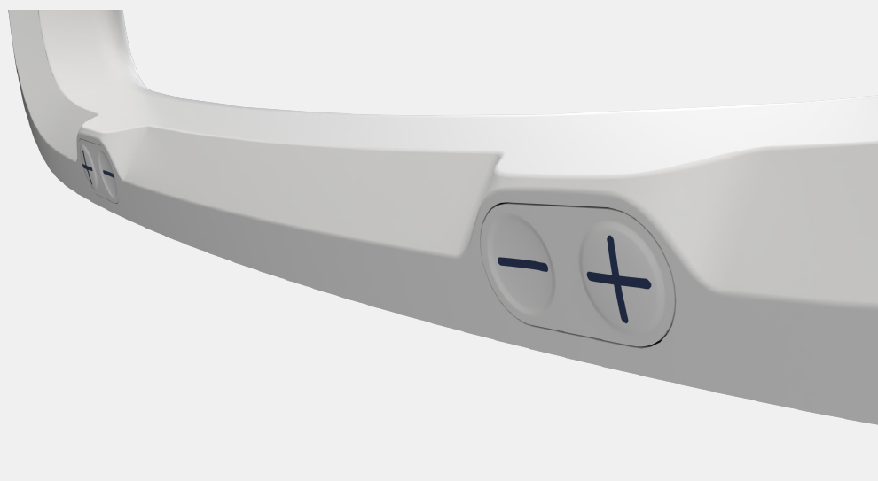
OPERATING THE OTC
FULL INTEGRATION
Patient information
Exposure parameters
Collimator parameters
Light indication
Release all directions (backside)
Release all directions (backside)
Release in all directions - easy movements
Release in one direction
Up / down
Up / down easy accessible for both left- and righthanded
Easy to reach knobs for manual collimator adjustments.

Slide 26
THE TABLE - A DEEPER LOOK

Slide 27
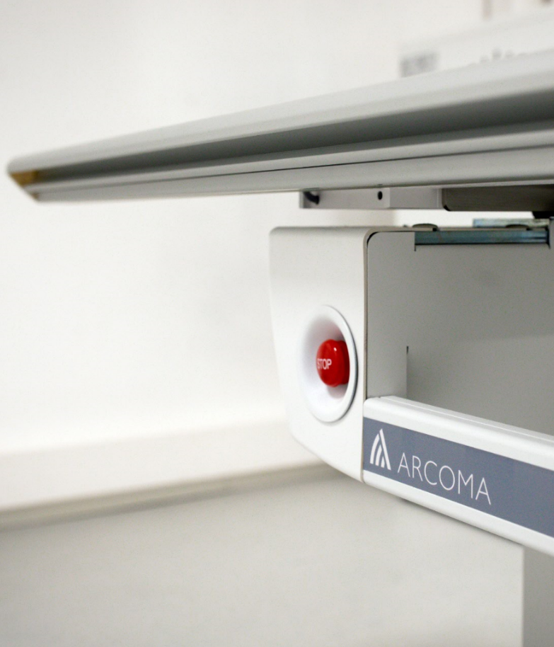
HIGH CAPACITY EXAMINATION TABLE
SMOOTH MOVEMENT
Easy and smooth to adjust to the preferred position.
CAPACITY FOR LARGER PATIENTS
Large table top with extension possibility. Patient weight capacity up to 300kg/660lbs.
EASY PATIENT ACCESS
Open table design that optimizes patient access and infection disease control.
Notes:
For info! There will be a sound (lower than today) when the brakes are released. I think this is good, it is a nice sound and warns the patient that something is happening - and gives feedback to the user that the brakes are released.

Slide 28
TABLE - FEATURES
FEATURES
Power supplies without fans in table
Wired and Wireless foot controls (options)
Weight capacity of 300 kg/660 lbs (dynamic)
Large table top with long table stroke
X-ray from skull to toe without moving the patient
OTC automatic tracking table detector
Low position for easy access

Slide 29
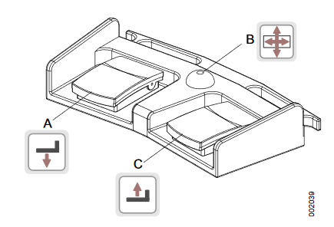
OPERATING THE TABLE
Wired foot control
Wireless foot control
Move table upwards
Table hand grip rail
Table hand control
OTC to left in pendulum mode
Release brakes
OTC to right in pendulum mode
Image receptor holder right
Move table downwards
Image receptor holder left

Slide 30
THE DETECTORS - A DEEPER LOOK

Slide 31
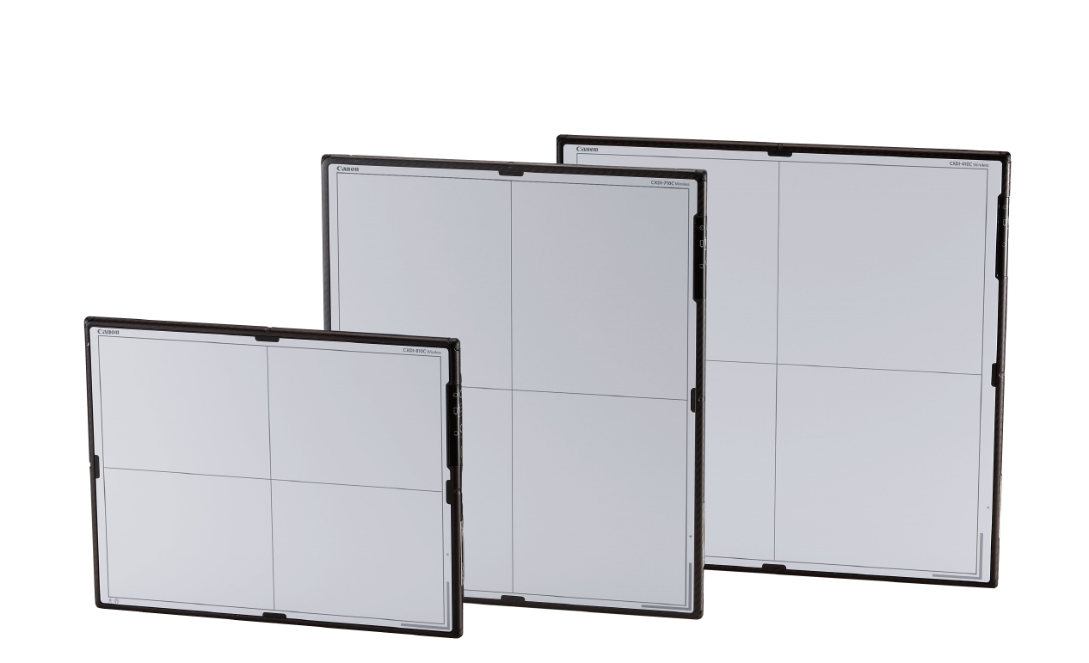
CANON DETECTORS
Arcoma Precision is powered by detectors from Canon.
With more than 100 years of experience within medical imaging Canon delivers the most advanced detector solutions on the market.

Slide 32
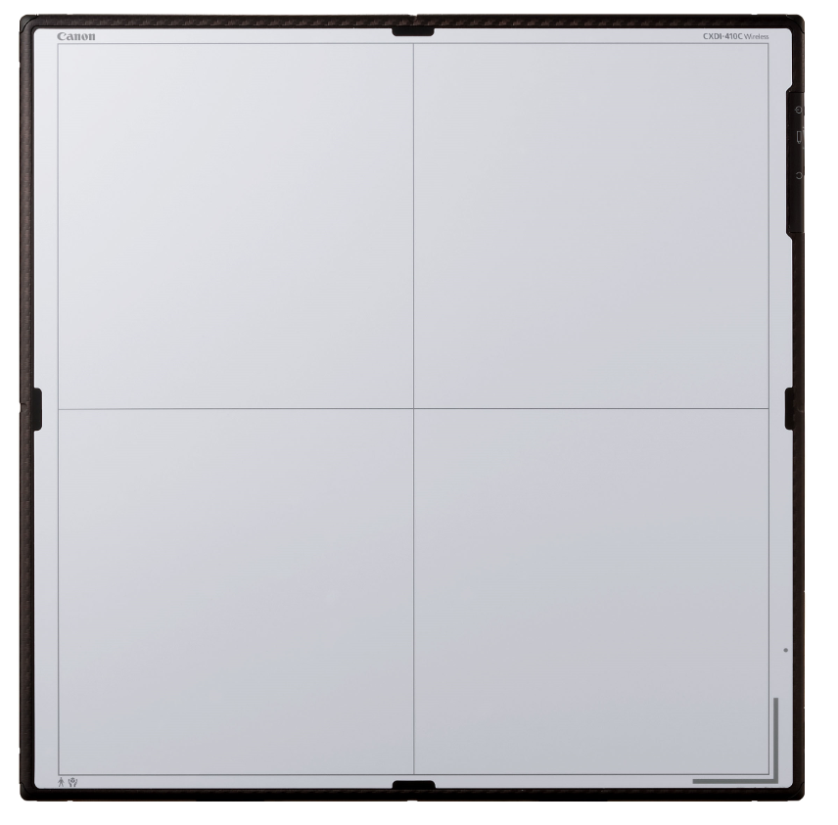
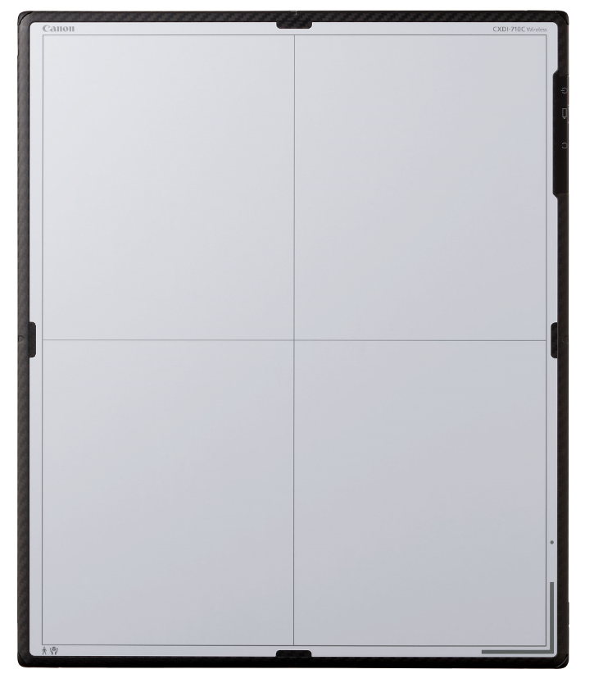
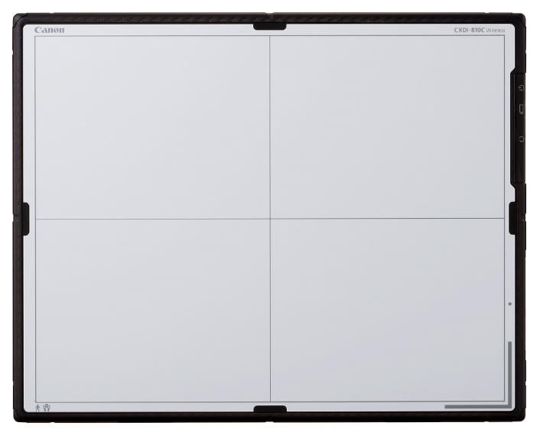
THE DETECTORS
CXDI-410C W
CXDI-710C W
CXDI-810C W
CXDI-401C Compact
Wireless
2,8 kg
Size: 42,6 x 41,5 cm
Effective image area: 426x 415mm
Image matrix size: 3320 x 3408 mm
Wireless
2,3 kg
Size: 35.0x42.6 cm
Effective image area: 350 x 426 mm
Image matrix size: 2800 x 3408pixels
Wireless
1,8 kg
Size: 35.0x27.4 cm
Effective image area: 350 x 274 mm
Image matrix size: 2800 x 2192 mm
Fixed
Size: Approx. 46.0 (W) x 49.0 (H) x 15 (D) cm
Effective image area: 415x426 mm
Image matrix size: 3320x 3408 pixels

Slide 33
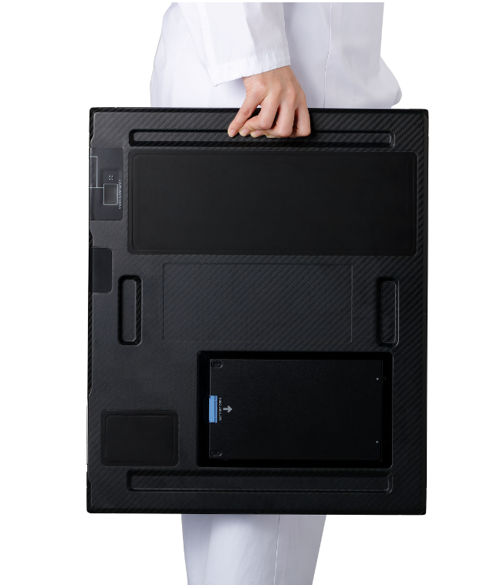
DETECTOR BENEFITS
NONSTOP USE WITH DURABLE DESIGN
Strong and durable design as well as IPX7 waterproof ensures nonstop use.
LIGHTWEIGHT AND ERGONOMIC
Ultralight easy to use detectors supports increased workflow and ergonomic for the user.
PERFECT IMAGE QUALITY
High resolution, high sensitivity and high signal to noise performance ensures perfect image quality without increasing dose.

Slide 34
DETECTOR - FEATURES
FEATURES
Load capacity of 310 kg
Waterproof - IPX7 compliant
On-board image storage – up to 99 images
Multi-function docking station
Super-lightweight design – the lightest 1,8 kg
Handgrips for easy transfer
Colour coding
Preview image time: 1 seconds
Cycle time: 7 seconds

Slide 35
DETECTOR INTEGRATION WITH FULL FLEXIBILITY
Detector | Wall stand | Table | Free | Details:
CXDI-410C | yes | yes | Yes | Wireless 42,6 x 1,5 cm 2,8 kg
 | Status indicator Charging in holder | Status indicator Charging in holder
CXDI-710C | yes | yes | Yes | Wireless 35,0 x 42,6 cm 2,3 kg
 | Status indicator Charging in holder | Status indicator Charging in holder
CXDI-810C | Not applicable | Not applicable | yes | Wireless 35,0 x 27,4 cm 1,8 kg
CXDI-401C Compact | yes | yes | Not applicable | Fix 46 x 49 cm
Other options: | Left/Right hand loading of grid & Wireless detector | Not applicable | Not applicable
The wall stand and the table can hold either the CXI-710C W, CXDI-401C W or the CXDI-401C Compact.
Wireless image transfer for the CXDI-710C W and CXDI-410C W.
Automatic charging of battery when the detectors are placed in the detector holders.
Free: CXDI-810C W
CXDI-710C W
CXDI-410C W
CXDI-410C Compact

Slide 36
THE ACCESSORIES

Slide 37
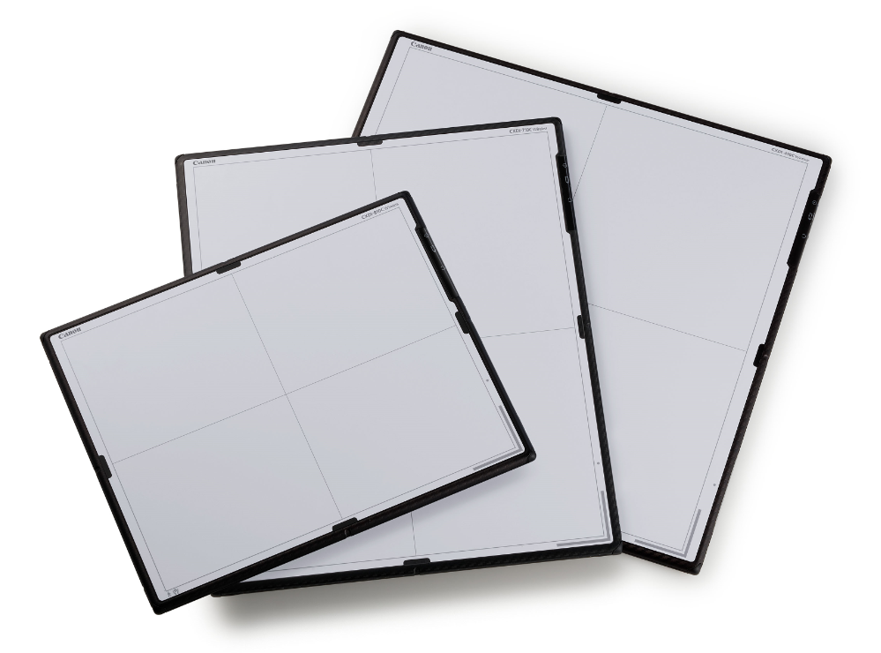
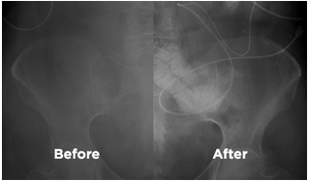
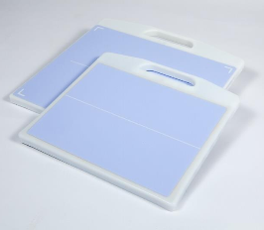
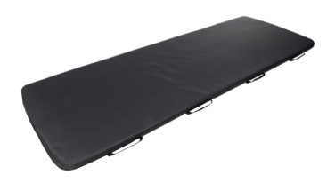
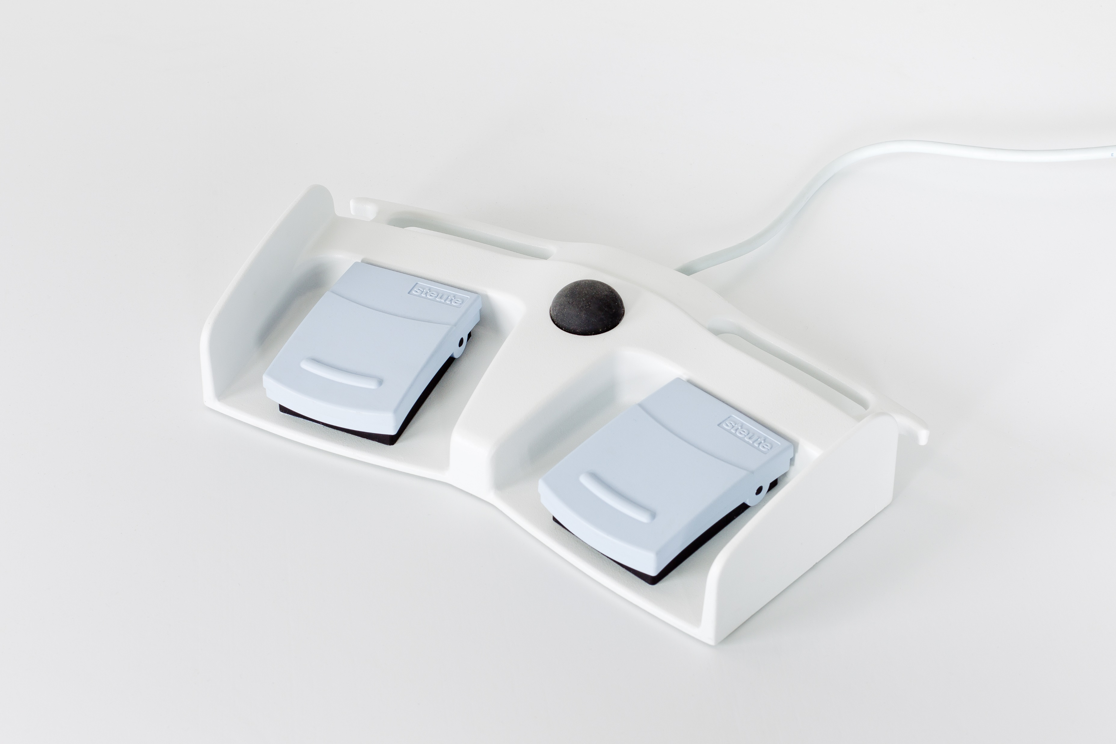
ACCESSORIES
Full range of accessories avaliable. Examples below:
See all at our website: www.arcoma.se
Detectors
Scatter correction software
Form pads
Detector holders
Mattresses
Foot controls

