Slide 1
WORLD CLASS DIGITAL X-RAY SYSTEMS
Introduction – Sales, market and customers EMEA (Europe, Middle East, and Africa)
Notes:
Strength of Arcoma as OEM manufacturer for past 25 years > list down all brands and product nameGlobal map of installations to-date – use bubble chart on a global mapTimeline showcase of how Arcoma’s technology has evolved through the yearsHighlight our 1st -in-class technology eg. Auto-positioning
Our cost-effectiveness (not cheapest but cost-effective)Talk about Total Cost of ownership
Our design are modular (verify with RnD) > post-sales service only require replacement of parts and not whole system
A high-level service break-down rate, relatively low > get estimated % from Jonas
Distributors gets revenue & margin from post-sales warranty
Highlight our latest i5 launch > show continuous improvement capability to suit marketsSome photos of Arcoma new production & office facility > we take pride in strict adherence to production and qualityCustomer testimonials and photos

Slide 2
SHORT FACTS
DISTRIBUTION IN EMEA STARTED IN 1990
Quite big market share in the Nordic countries.
ARCOMA SELL THROUGH 14 DISTRIBUTORS IN EUROPE/EMEA
MAIN COMPETITORS: PHILIPS, GE, SAMSUNG AND SIEMENS
73% of Arcoma revenue (2019)
Size of diagnostic imaging market: USD 9.18 billion in 2020

Slide 3
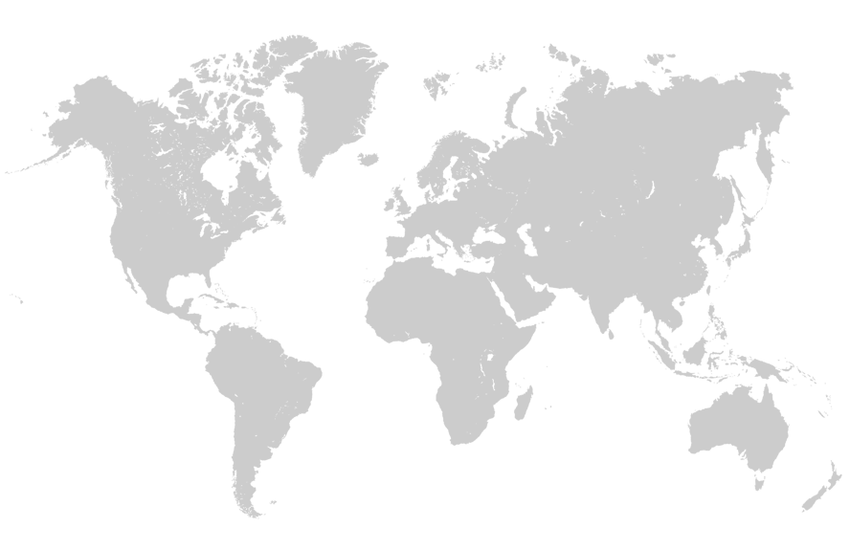
MORE THAN 3500 SYSTEMS
INSTALLED GLOBALLY
NORTH
AMERICA
AROUND 700 SYSTEMS
EUROPE
AROUND 2300 SYSTEMS
ASIA
AROUND 500 SYSTEMS
(incl. IMIX)
Notes:
Europe: 2300 systems
North America: 700 systems
Asia: 500 systems
Distribution in asia started 2014.

Slide 4
EMEA
No. of installed systems
Numbers includes both OEM partner sold systems and systems sold by distributors. Numbers based on internal estimates.

Slide 5
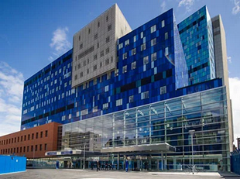
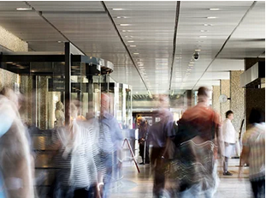
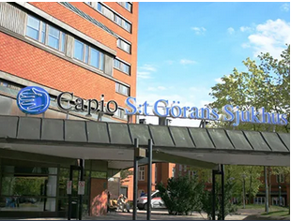
EXAMPLE OF INSTALLATIONS - EMEA
Royal London Hospital
Great Britain
Rigshospitalet Hospital
Denmark
St:Görans Hospital
Sweden
Notes:
Add customer testimonials?

Slide 6
Sales – Asia Pacific

Slide 7
Global SALES
% of total revenue - Arcoma
Revenue
Year | Revenue EMEA | Revenue Sweden
2018 | 81 600 kSEK | 5 654 kSEK
2019 | 91 096 kSEK | 9 397 kSEK
Sweden
Europe
America
Asia
Notes:
Add customer testimonials?

Slide 8
Market – EMEA

Slide 9
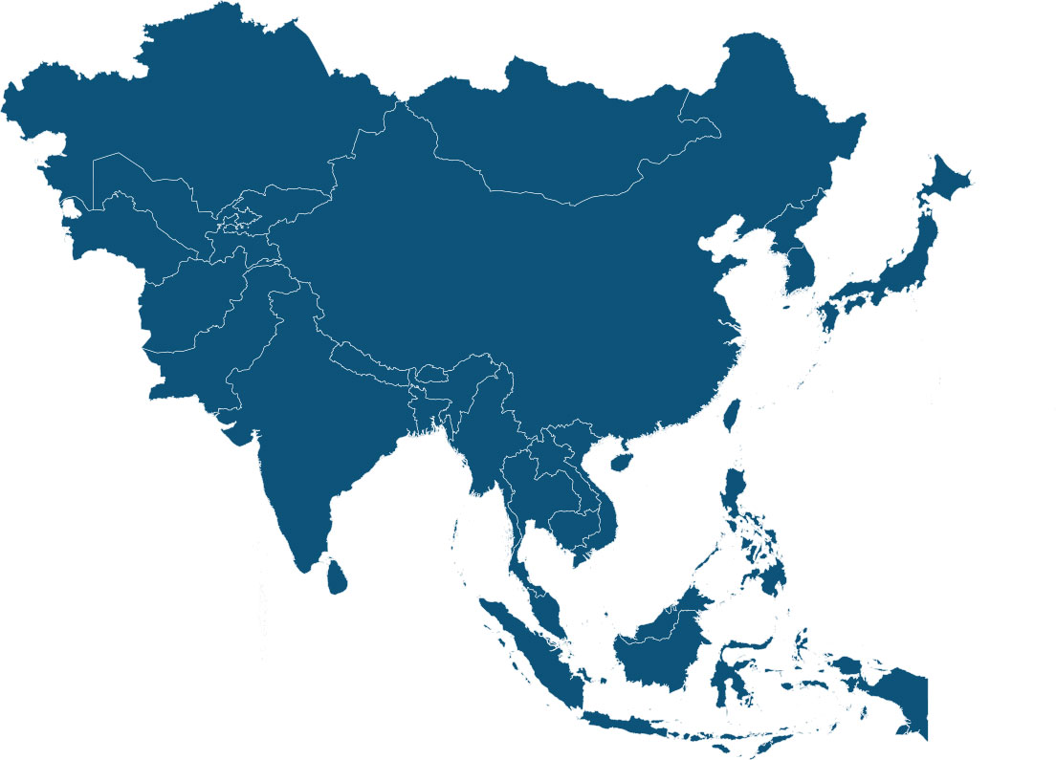
MAIN COMPETITORS – EMEA (ARCOMA SYSTEMS)
Note: Numbers based on internal estimates.
Notes:
More than 27 countries

Slide 10
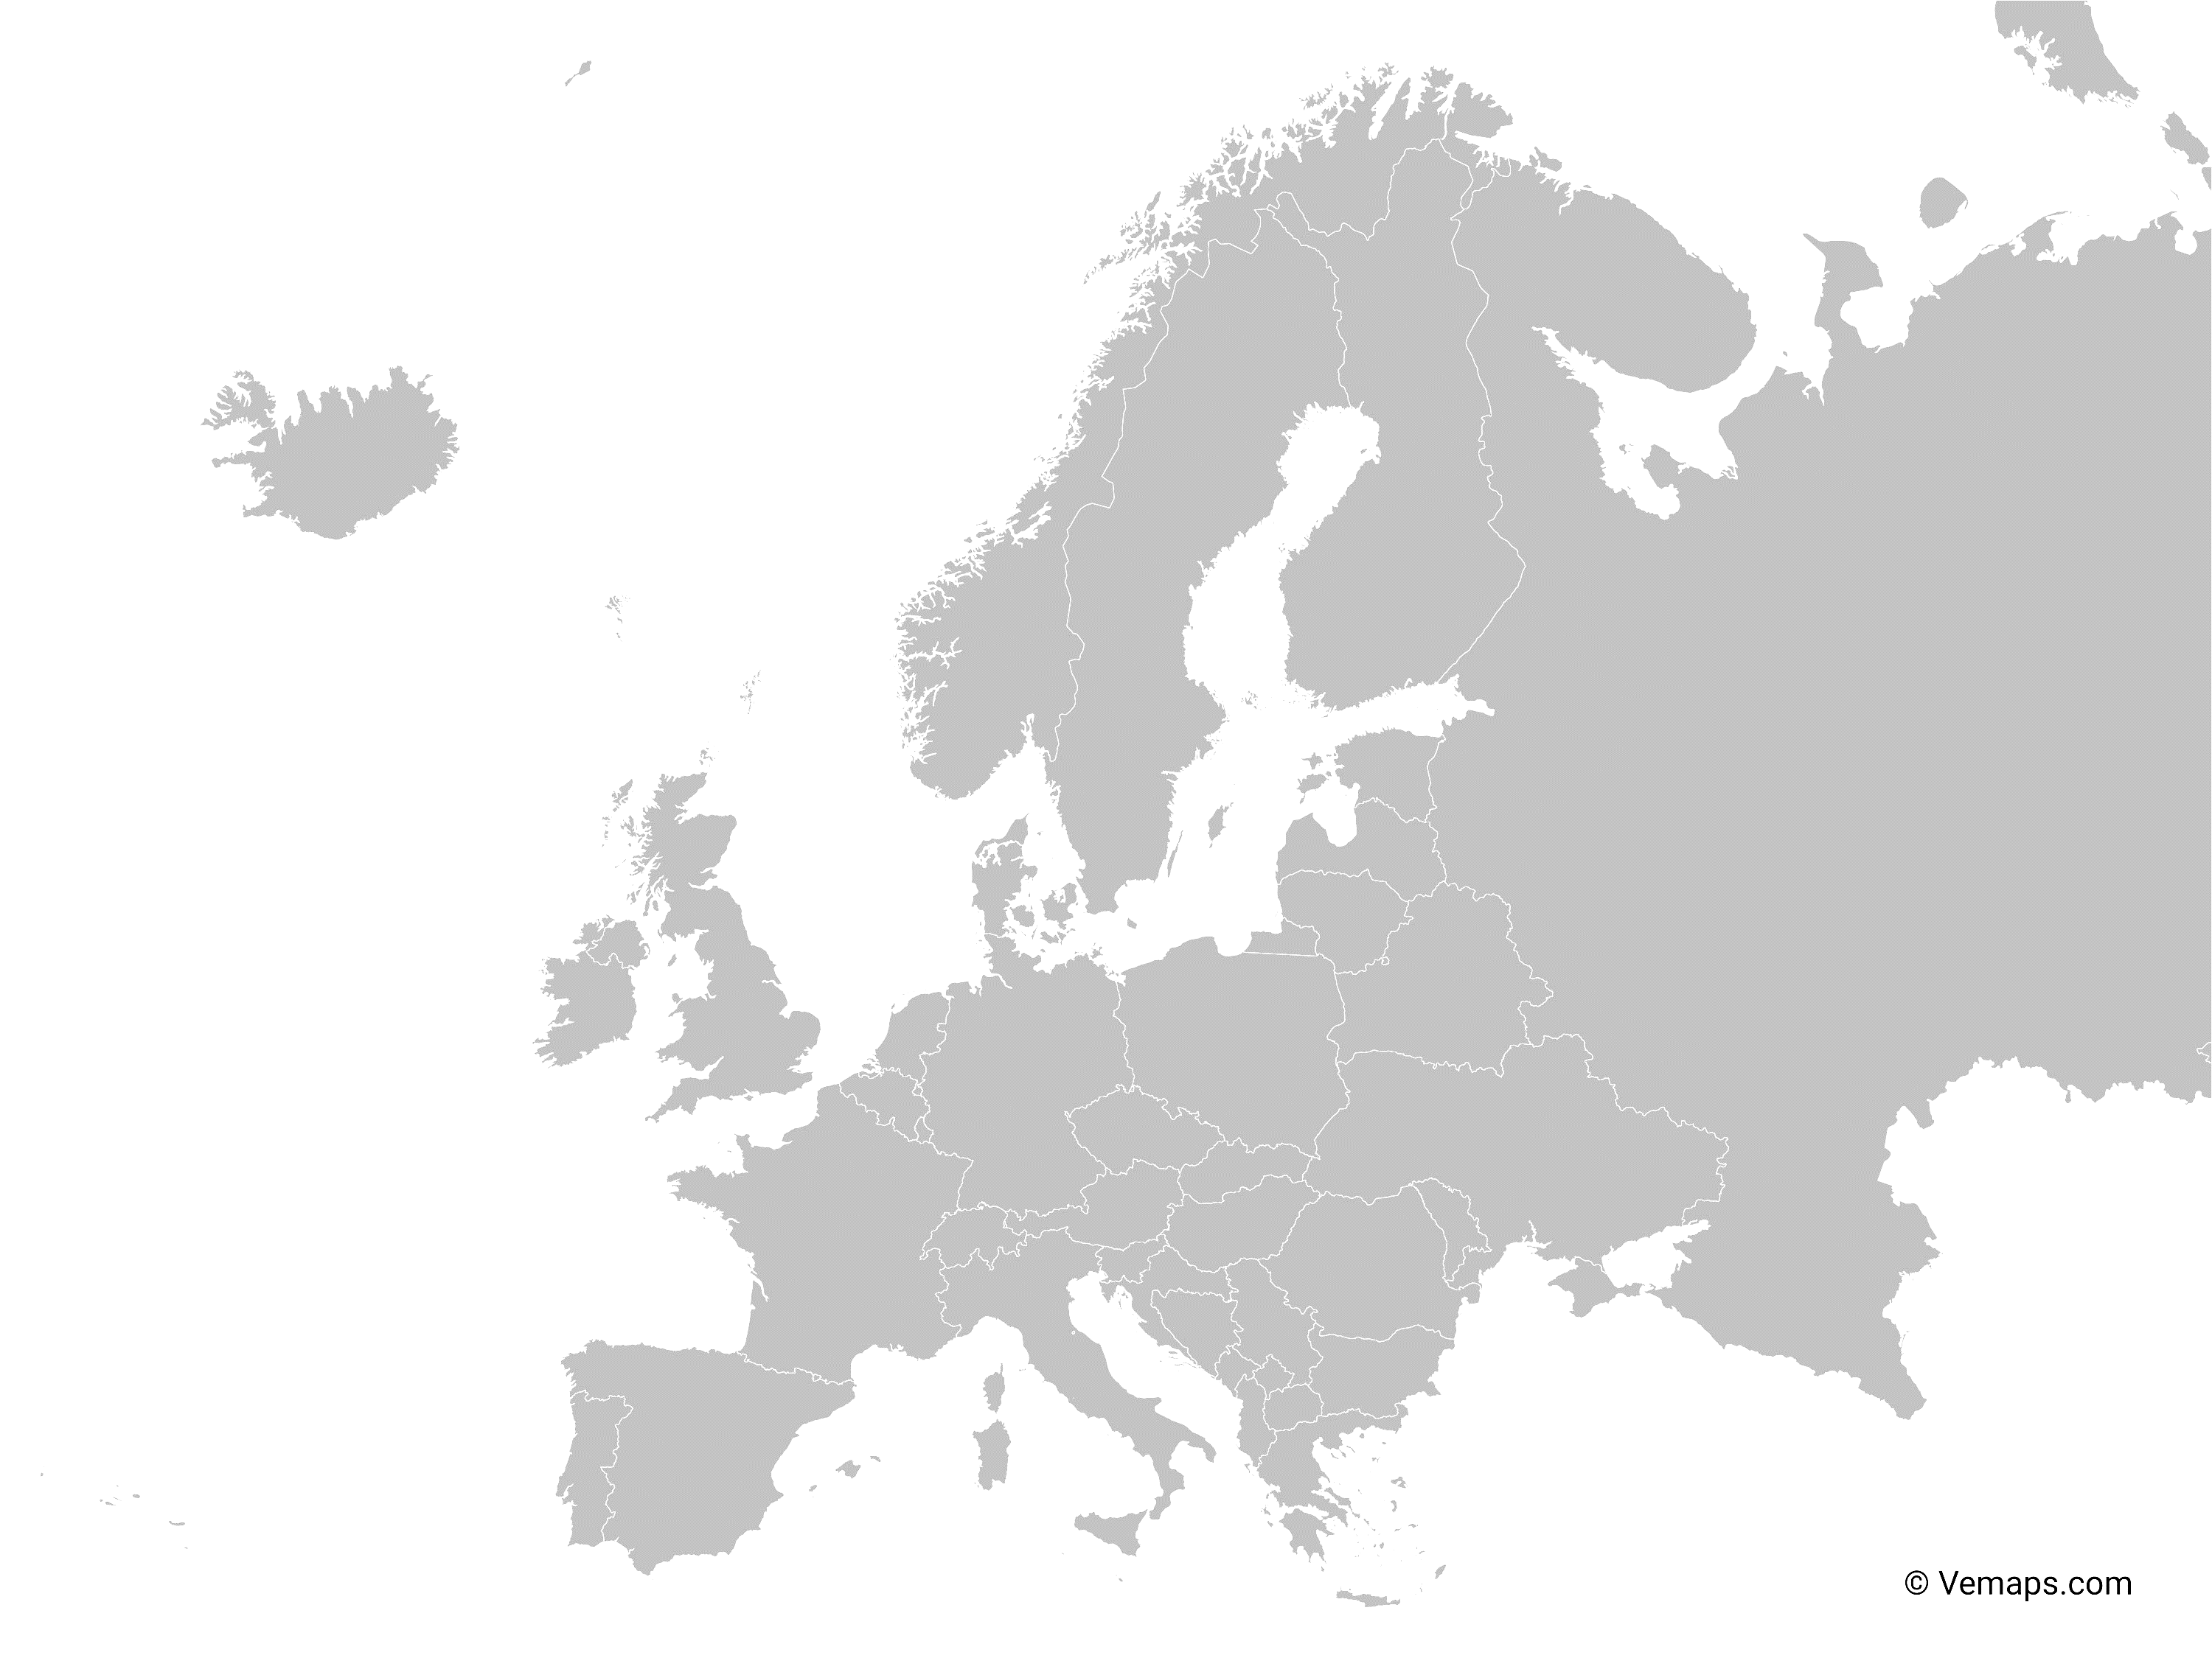
THE MARKET
The size of the Europe diagnostic Imaging market was worth USD 9.18 billion in 2020 and is estimated to be growing at a CAGR of 6.70% to reach USD 12.7 billion by 2025.
The major factors for the growth of the market include:
Increase in the geriatric population
Rising prevalence of chronic diseases
Technological advancement in imaging modalities.
Rising adoption of medical imaging devices.
https://www.marketdataforecast.com/market-reports/europe-diagnostic-imaging-market
Notes:
More than 27 countries

Slide 11
EXAMPLES OF OUR MARKET SHARE
Ceiling mounted radiography systems
The Nordics
UK
Note: Numbers based on internal estimates.
Notes:
More than 27 countries

Slide 12
Distributors EMEA

Slide 13
DISTRIBUTORS IN ASIA-PACIFIC
Country | Distributor
Czech republic | AURA Medical s.r.o.
Denmark | Santax Medico A/S
Finland | LifeMed Oy
Germany | MTS, Medizintechnische Service GmbH
Norway | Decotron AS
Poland | Meditech
Schweiz | Leuag AG
Slovakia / Hungary | GUTTA Slovakia
Barbados/Jamaica | Lighthouse Medical
Sweden | Mediel AB
 | Medivet Scandinavian AB
Ukraine | Mistral
UK | Wolversson X-ray
 | Xograph healthcare Ltd
We also have “inactive” distributors in Austria, Germany, Scotland and Turkey which we have contract with but have not sold any system.
Notes:
Add customer testimonials?

Slide 14
Closer look at some distributors.
SANTAX (Denmark)
Offering
Offices in: Arhus, Copenhagen
Conventional X-ray
Computed Tomography
MRI (Magnetic Resonance Imaging)
Ultrasound Equipment
www.santax.com
Decotron Norway is part of Santax Nordic Group.
Sell products from among others:
65 years of experience
Notes:
Add customer testimonials?

Slide 15
Closer look at some distributors.
Mediel AB (Sweden)
Offering
Offices in: Gothenburg, Stockholm
Conventional X-ray
Computed Tomography
www.mediel.se
Sell products from among others:
Established 1982
Notes:
Add customer testimonials?

Slide 16
Closer look at some distributors.
Xograph (UK)
Offering
Offices in: UK and Ireland
Conventional X-ray
www.xograph.com
Sell products from among others:
Established 1967
Notes:
Add customer testimonials?

Slide 17
Closer look at some distributors.
Lifemed (Finland)
Offering
Offices in: SIUNTIO
Conventional X-ray
Ultrasound Equipment
www.lifemed.fi
Sell products from among others:
Established 1981
Notes:
Add customer testimonials?

Slide 18
THANK YOU
Arcoma AB | Annavägen 1 | 352 46 Växjö | Sweden
PHONE
EMAIL
WEBSITE
+46 470 70 69 00
service@arcoma.se
www.arcoma.se
Notes:
Add take away

