Slide 1
WORLD CLASS DIGITAL X-RAY SYSTEMS
Introduction – Sales, market and customers ASIA/Pacific
Notes:
Strength of Arcoma as OEM manufacturer for past 25 years > list down all brands and product nameGlobal map of installations to-date – use bubble chart on a global mapTimeline showcase of how Arcoma’s technology has evolved through the yearsHighlight our 1st -in-class technology eg. Auto-positioning
Our cost-effectiveness (not cheapest but cost-effective)Talk about Total Cost of ownership
Our design are modular (verify with RnD) > post-sales service only require replacement of parts and not whole system
A high-level service break-down rate, relatively low > get estimated % from Jonas
Distributors gets revenue & margin from post-sales warranty
Highlight our latest i5 launch > show continuous improvement capability to suit marketsSome photos of Arcoma new production & office facility > we take pride in strict adherence to production and qualityCustomer testimonials and photos

Slide 2
SHORT FACTS
DISTRIBUTION IN ASIA STARTED IN 2014
Arcoma AB merged with IMIX ADR Ltd in 2010 and has around 400 IMIX systems installed in Asia.
ARCOMA SELL THROUGH 6 DISTRIBUTORS IN ASIA
MAIN COMPETITORS: PHILIPS, SIEMENS, Carestream and SHIMADZU
5% of Arcoma revenue
Size of diagnostic imaging market: USD 7.93 billion in 2020

Slide 3
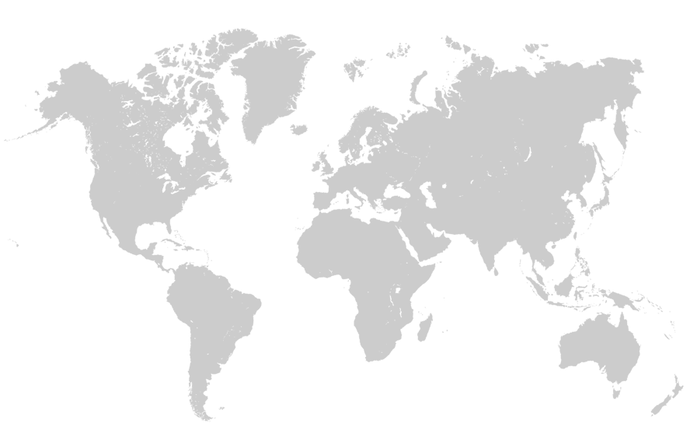
MORE THAN 3500 SYSTEMS
INSTALLED GLOBALLY
NORTH
AMERICA
AROUND 700 SYSTEMS
EUROPE
AROUND 2300 SYSTEMS
ASIA
AROUND 500 SYSTEMS
(incl. IMIX)
Notes:
Europe: 2300 systems
North America: 700 systems
Asia: 500 systems
Distribution in asia started 2014.

Slide 4
ASIA
Countries with most installed systems
Country | No of installed systems
India | 58
Hong Kong | 40
Iran | 40
Thailand | 20
Turkey | 30
Singapore | 7
China | 6
Korea | 5

Slide 5
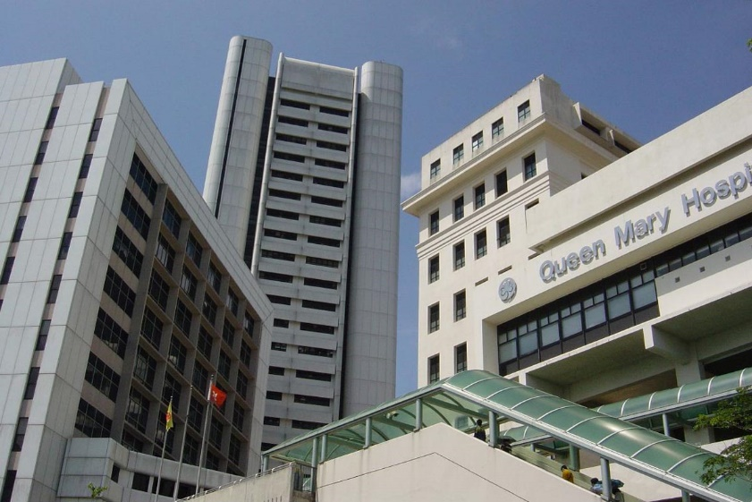
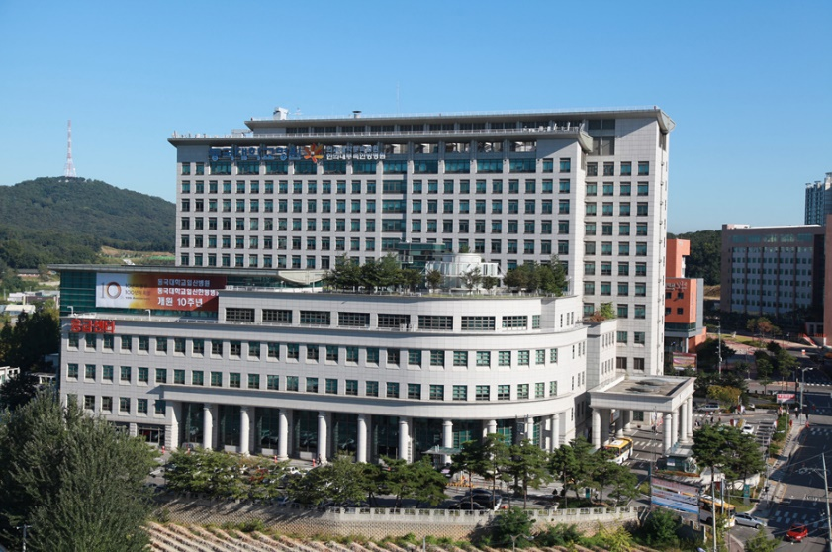
EXAMPLE OF INSTALLATIONS - ASIA
Queen Mary Hospital
Hong Kong
National University Hospital
Singapore
Ilsan University Hospital
South Korea
Notes:
Add customer testimonials?

Slide 6
Sales – Asia Pacific

Slide 7
SALES ASIA-PACIFIC
% of total revenue - Arcoma
Revenue
Year | Revenue
2018 | 10311 kSEK
2019 | 6892 kSEK
Sweden
Europe
America
Asia
Notes:
Add customer testimonials?

Slide 8
Market – Asia Pacific

Slide 9
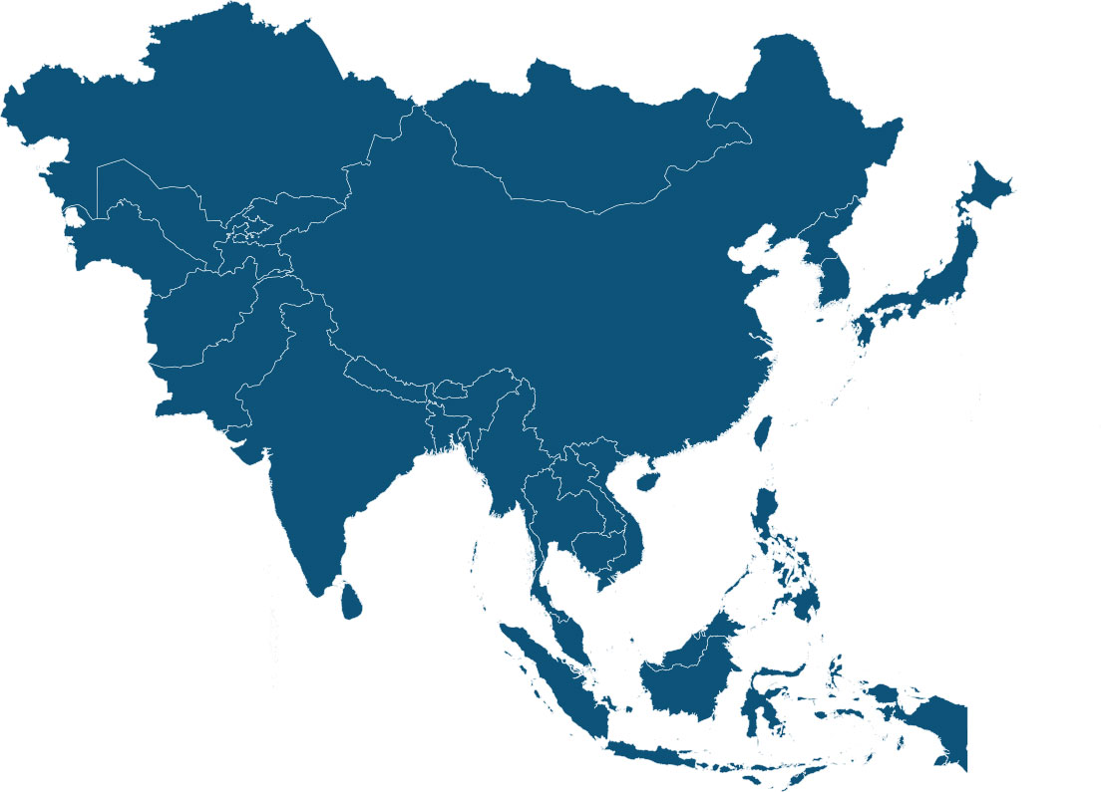
MAIN COMPETITORS – ASIA (ARCOMA SYSTEMS)
Note: Numbers based on internal estimates.
Notes:
More than 27 countries

Slide 10
THE MARKET
The size of the Diagnostic Imaging Market in the Asia Pacific was worth USD 7.93 billion in 2020 and estimated to be growing at a CAGR of 6.90% to reach USD 11.07 billion by 2025.
Rise in healthcare expenditure and constant improvement of medical healthcare facilities in countries like Japan, India, and China are the major growth drivers of the market.
Source: https://www.marketwatch.com/press-release/asia-pacific-diagnostic-imaging-market-by-size-growth-opportunity-and-forecast-to-2025-2020-08-03?tesla=y
Notes:
More than 27 countries

Slide 11
MARKET SHARE - THAILAND
Ceiling mounted radiography systems
Thailand
Note: Numbers based on internal estimates.
Notes:
More than 27 countries

Slide 12
Distributors Asia Pacific

Slide 13
DISTRIBUTORS IN ASIA-PACIFIC
Country | Distributor | Detectors
India | Konica Minolta Healthcare India Pvt. Ltd Medion Healthcare Pvt Ltd
Singapore Hong Kong Malaysia | QST Technologies (HK) Co.Ltd | Canon detectors
Taiwan | Nan Kai Corporation
Indonesia | PT Inmed Teknotama Cemerlang
Thailand | Thai GL. Co. Ltd. | Canon detectors
South Korea | NEODEA CO.,LTD. | Canon detectors
Notes:
Add customer testimonials?

Slide 14
Closer look at some distributors.
THAI GL
Which areas do they sell in?
Offering
Conventional X-ray
Computed Tomography
Molecular Imaging Equipment(?)
MRI (Magnetic Resonance Imaging)
Ultrasound Equipment
www.thaigl.co.th
Offices in: Bangkok, Thailand
Sell products from among others:
Established in 1994
Notes:
Add customer testimonials?

Slide 15
Closer look at some distributors.
QST TECHNOLOGIES
Offering
Conventional X-ray
Computed Tomography
Molecular Imaging Equipment(?)
MRI (Magnetic Resonance Imaging)
Ultrasound Equipment
www.qsttech.com
Offices in: Singapore, Malaysia and Hong Kong
Sell products from among others:
Established in 2005
Notes:
Add customer testimonials?

Slide 16
THANK YOU
Arcoma AB | Annavägen 1 | 352 46 Växjö | Sweden
PHONE
EMAIL
WEBSITE
+46 470 70 69 00
service@arcoma.se
www.arcoma.se
Notes:
Add take away

