Slide 1
Competitors

Slide 2
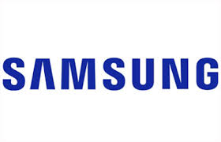
Main competitors
Notes:
Conventional x-ray is our only focus!
We are best when it comes to that…

Slide 3
Competitors vary per market
Main competitors vary per market
#1 in DR in Europe most likely Siemens
Arcoma often competes with Carestream in Asia
Europe
Asia
USA
Notes:
Conventional x-ray is our only focus!
We are best when it comes to that…

Slide 4
A deeper look – some competitors

Slide 5
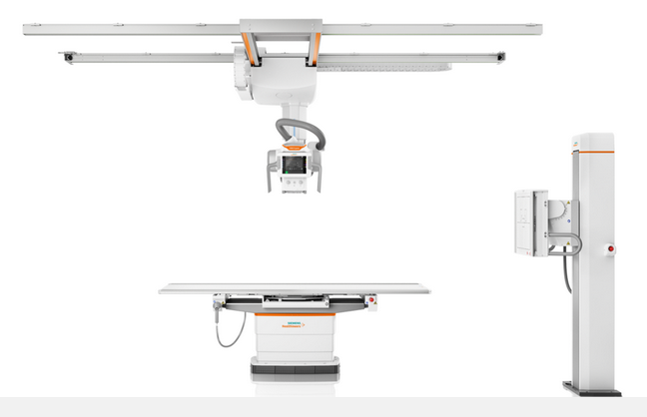
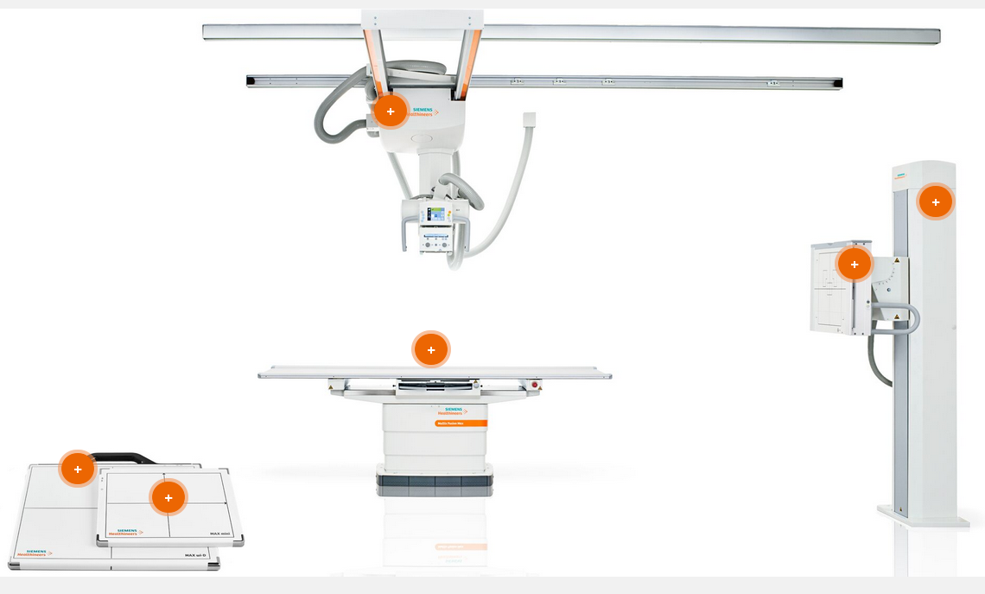
SIEMENS Healthineers
Over 50,000 employees in more than 70 countries.
Revenue: € 14.5 billion
Revenue imaging: € 8.9 billion
(2019 numbers)
Offering
Competitor system for Arcoma Precision i5
Ysio Xpree
Competitor system for Arcoma Intuition
→ Multi Fusion Max
Conventional X-ray
Computed Tomography
Molecular Imaging Equipment
MRI (Magnetic Resonance Imaging)
Ultrasound Equipment
Notes:
Conventional x-ray is our only focus!
We are best when it comes to that…

Slide 6
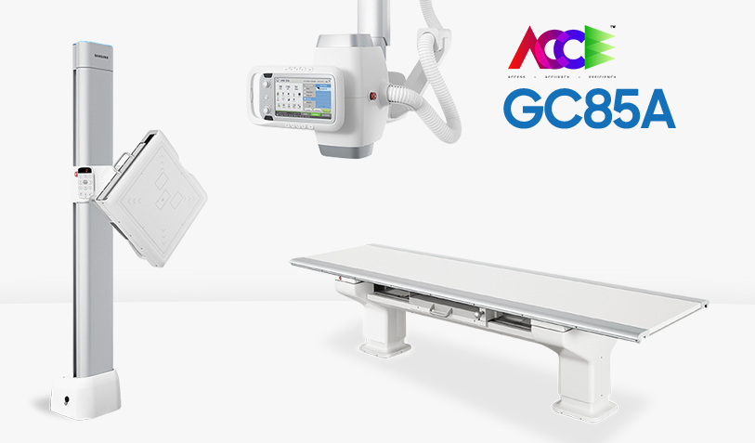
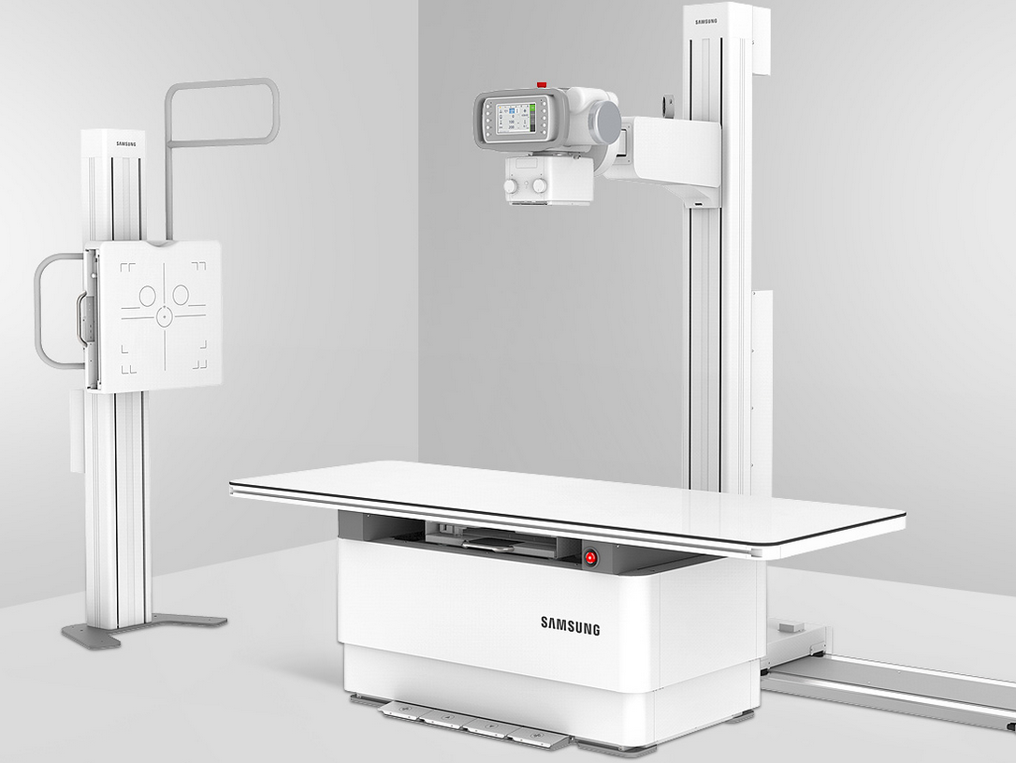
SAMSUNG
1,600 employees over 100 countries
Revenue: $ 10 billion (healthcare division)
(2020 estimated numbers.)
Offering
Competitor system for Arcoma Precision i5
iQuia GC85A
Competitor system for Arcoma Intuition
→ GF55
Conventional X-ray
Computed Tomography
Ultrasound Equipment
Notes:
Conventional x-ray is our only focus!
We are best when it comes to that…

Slide 7
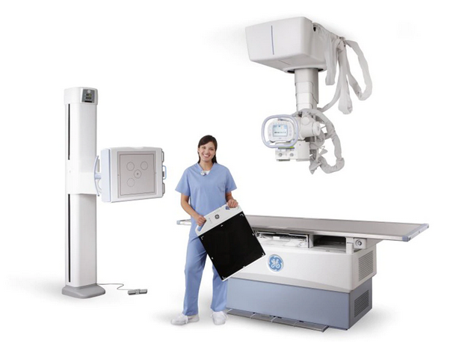
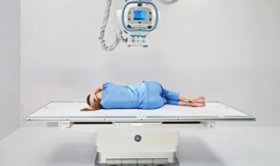
GE HEALTHCARE
50,000 employees globally
Sell to 160+ countries in the world
Revenue: $18.2 billion (healthcare division)
(2019 numbers.)
Offering
Competitor system for Arcoma Precision i5
XR656 HD6
Competitor system for Arcoma Intuition
→ XR646 HD
Conventional X-ray
Computed Tomography
Molecular Imaging Equipment
MRI (Magnetic Resonance Imaging)
Ultrasound Equipment
Notes:
Conventional x-ray is our only focus!
We are best when it comes to that…

Slide 8
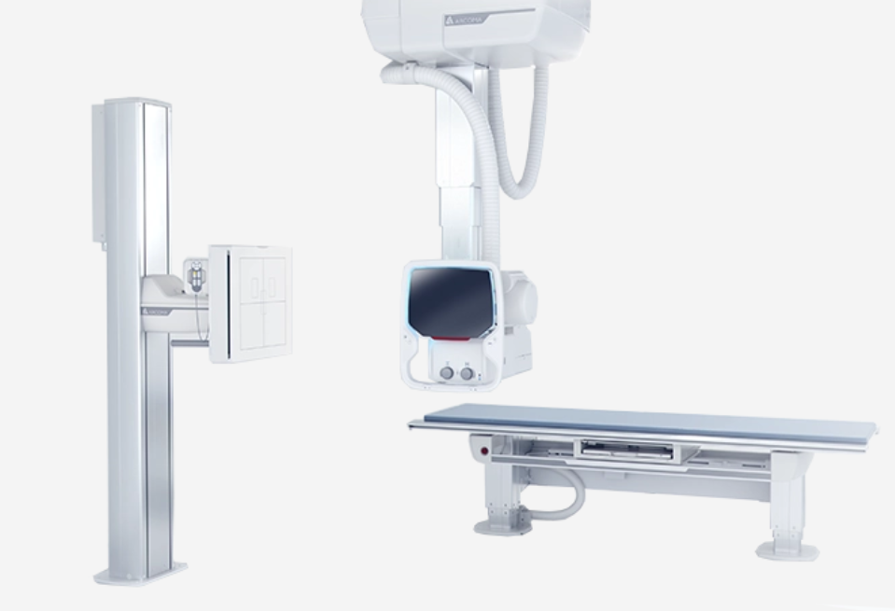
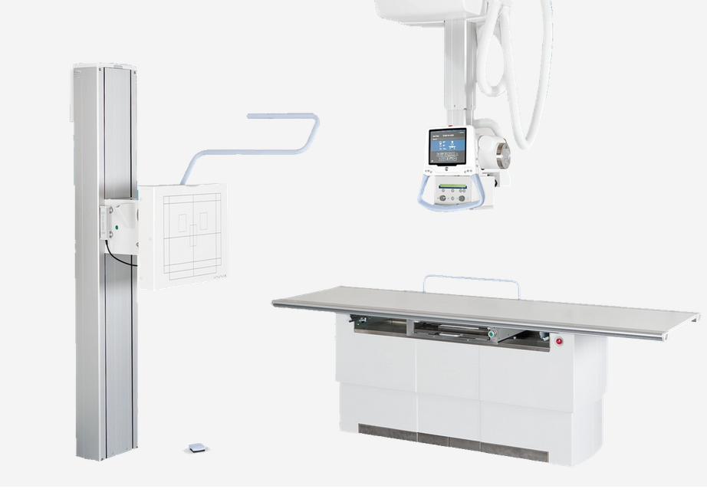
ARCOMA
30 employees
Sell to 17+ countries in the world
Revenue: 133 672 KSEK
(2019 numbers.)
Offering
Arcoma Precision i5
Arcoma Intuition
Conventional X-ray
”WE ARE EXPERTS ON CONVENTIONAL X-RAY”
Notes:
Conventional x-ray is our only focus!
We are best when it comes to that…

Slide 9
Product positioning

Slide 10
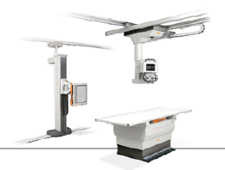
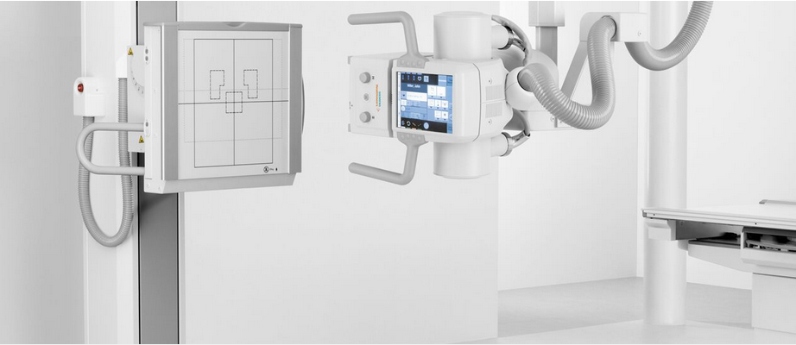
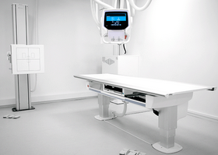
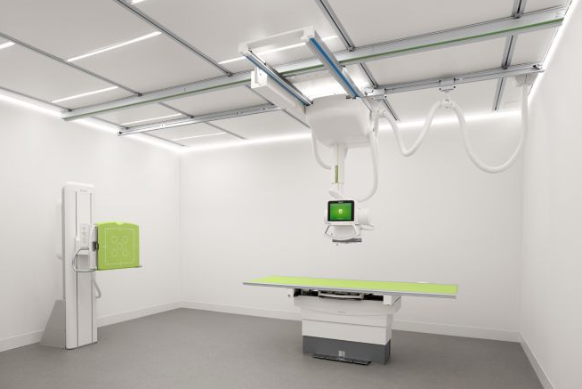
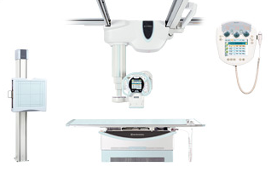
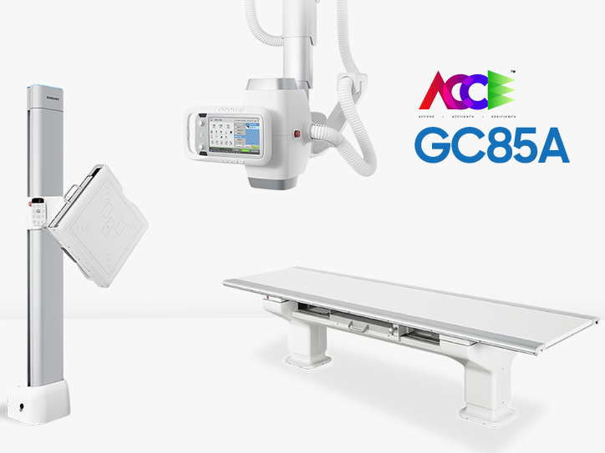
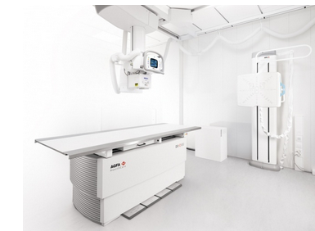
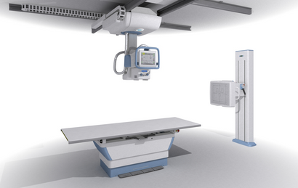
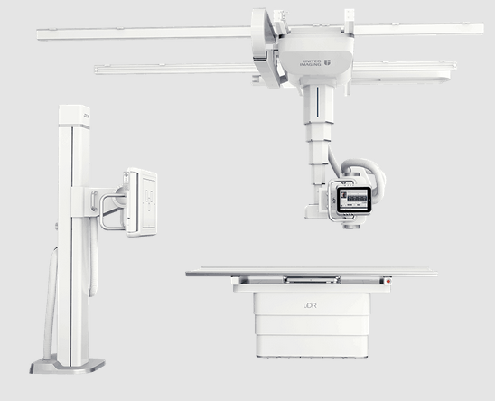
COMPETITORS OF ARCOMA PRECISION i5
DRX-Evolution Plus
Discovery XR656 HD6
Ysio Max
Arcoma Precision i5
Digital Diagnost C90
RADspeed Pro Style
iQuia GC85A
DR600
Challenge X
uDR780i

Slide 11
PRODUCT POSITIONING ARCOMA PRECISION i5 AND ITS COMPETITORS
High reliability/quality
Ysio Max
PRECISION i5
Digital Diagnost C90
iQuia GC85A
DRX-Evolution Plus
XR656 HD6/
Low features
DR600
High
features
uDR780i
RADspeed Pro Style
CHALLENGE-X
Low reliability/quality

