Slide 1
Introduction - Radiology

Slide 2
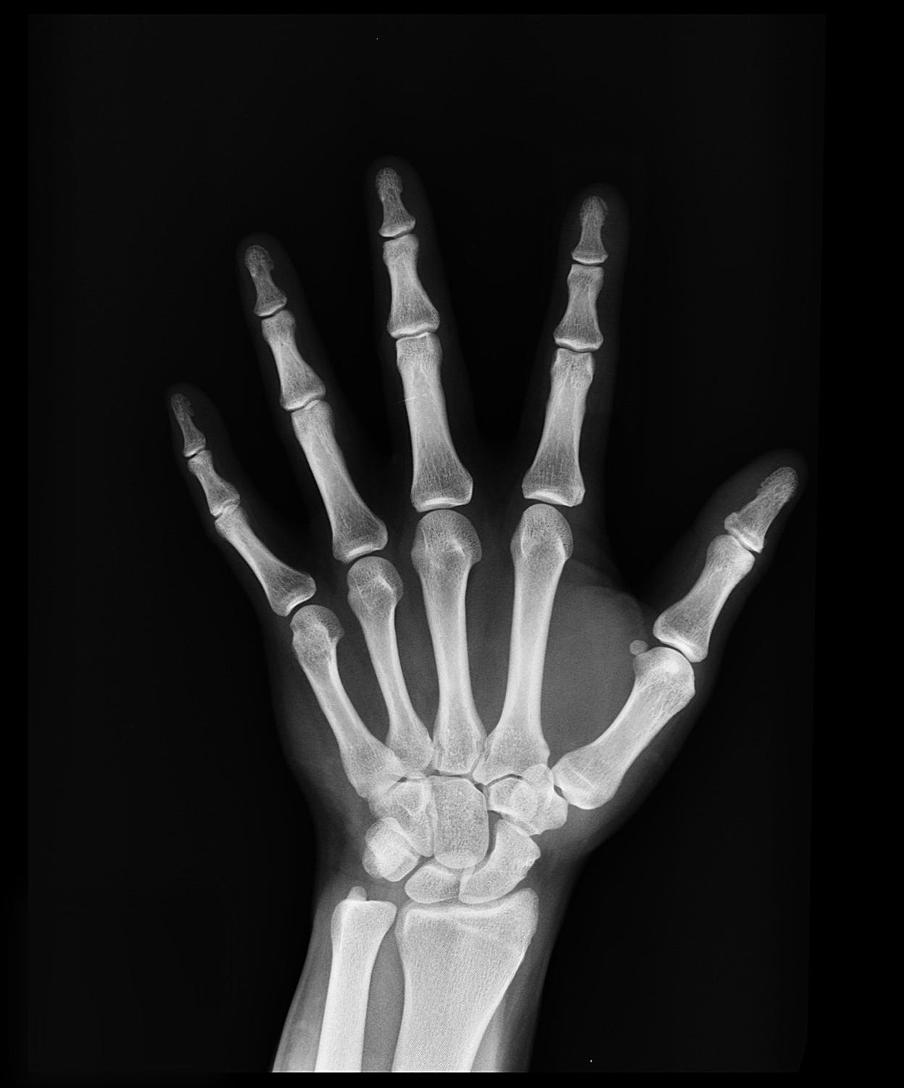
RADIOLOGY
Radiology is the medical discipline that uses medical imaging to diagnose and treat diseases within the bodies of animals, including humans.
Notes:
Conventional x-ray is our only focus!
We are best when it comes to that…

Slide 3
HISTORY
Notes:
Conventional x-ray is our only focus!
We are best when it comes to that…

Slide 4
THE RADIOLOGY TEAM
The radiologist is a medical doctor who has completed the appropriate post-graduate training and interprets medical images, communicates these findings to other physicians.
The nurse is involved in the care of patients before and after imaging or procedures, including administration of medications, monitoring of vital signs and monitoring of sedated patients.
The radiographer, also known as a "radiologic technologist" in some countries is a specially trained healthcare professional that produce medical images for the radiologist to interpret.
Notes:
Conventional x-ray is our only focus!
We are best when it comes to that…

Slide 5
THE RADIOLOGY MARKET
Conventional X-ray
Computed Tomography
Molecular Imaging Equipment
MRI (Magnetic Resonance Imaging)
Ultrasound Equipment
We are one of the very best and most experienced manufacturers of conventional x-ray in the world. This has been our only focus during our 30 years as a supplier.
Notes:
Conventional x-ray is our only focus!
We are best when it comes to that…

Slide 6
Number of examinations per year at a bigger hospital.
50 000 digital X-ray
25 000 computer tomografi
5 000 MRI
5 000 Ultrasound
Conventional X-rays are by far the largest in imaging
Market size >7 billion USD
Growing market
Growing needs

Slide 7
A deeper look – Radiology

Slide 8
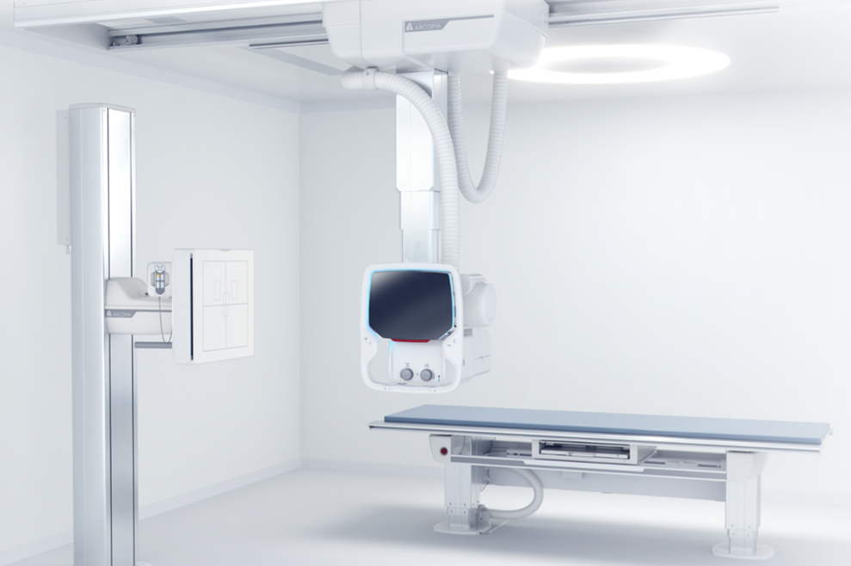
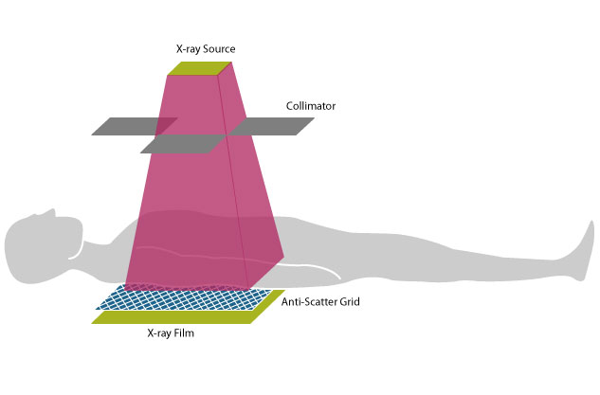
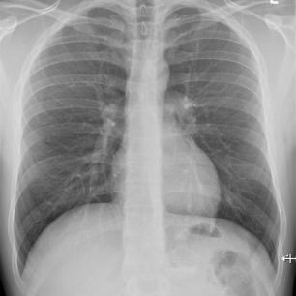
Conventional X-ray/Plain X-ray
SHORT FACTS:
X-ray imaging provides fast, high-resolution images and is relatively inexpensive.
The average examination for most plain film examinations takes no more than 10–15 minutes.
Requires no special preparation of the patient.
Conventional X-ray system – Arcoma Precision i5
The basic setup for X-ray imaging. The collimator restricts the beam of X-rays so as to irradiate only the region of interest.
The antiscatter grid increases tissue contrast by reducing the number of detected X-rays that have been scattered by tissue.
A typical X-ray radiograph aof the chest, in which the regions of bone appear white.
How does x-ray work? https://www.youtube.com/watch?v=hTz_rGP4v9Y

Slide 9
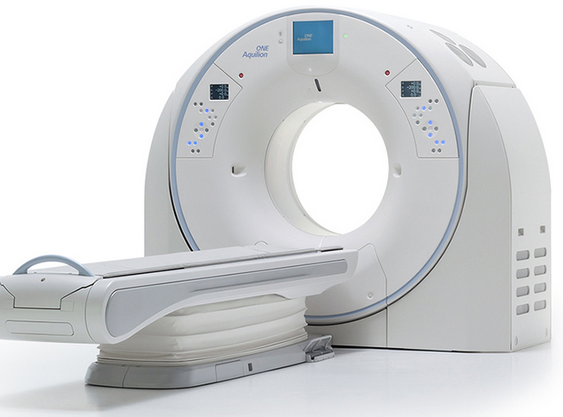
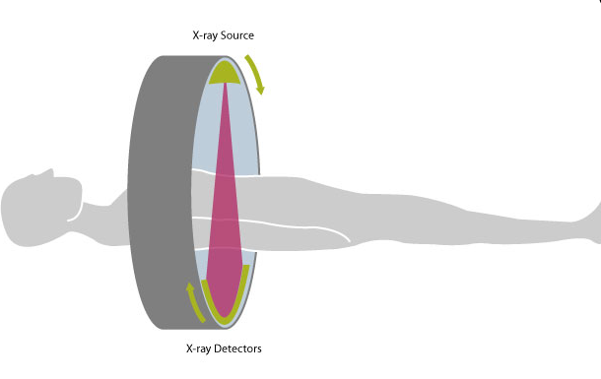
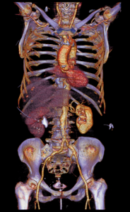
Computed Tomography (CT)
SHORT FACTS:
(CT) scanners have been available since the mid-1970s and have revolutionized medical imaging.
CT is widely used as it delivers detailed information fast.
CT scans provide far more detailed images than conventional X-ray imaging, especially in the case of blood vessels and soft tissue such as internal organs and muscles.
CT is used for example for assessing strokes, brain injuries, heart disease, and internal injuries.
CT - Aquilion ONE
The principle of computed tomography with an X-ray source and detector unit rotating synchronously around the patient. Data are acquired continuously during rotation.
Modern CT scans provide very detailed images, for example of blood vessels and internal organs, by using relatively low radiation doses.
How does CT work? https://www.youtube.com/watch?v=l9swbAtRRbg

Slide 10
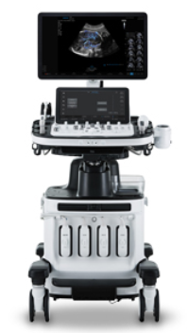
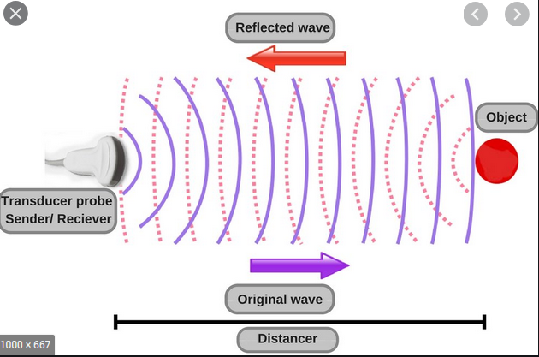
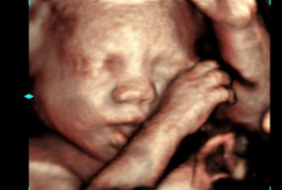
Ultrasound
SHORT FACTS:
Ultrasound has several advantages which make it ideal in numerous situations, especially moving structures in real-time.
Can be used to examine many parts of the body, such as the abdomen, heart and blood vessels, breasts, muscles, carotid arteries, and pregnancy.
It is a good choice for imaging when radiation-sensitivity is a concern, such as in pediatrics or in women of child-bearing age.
Ultrasound – Samsung HERA W10
The principle of ultrasound.
Prenatal 3D ultasound showing baby's head, arms and hand.
How does ultrasound work? https://www.youtube.com/watch?v=I1Bdp2tMFsY

Slide 11
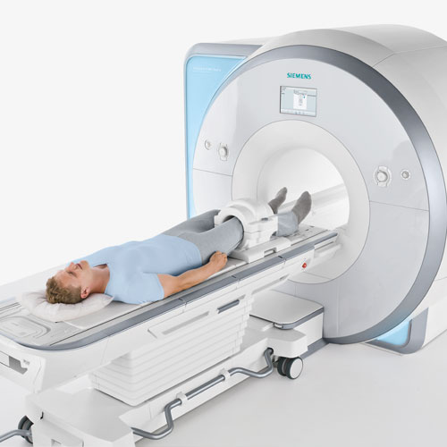
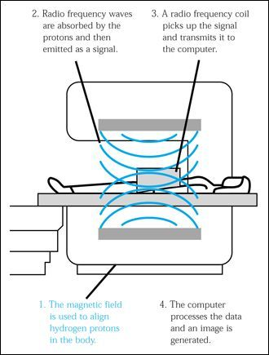
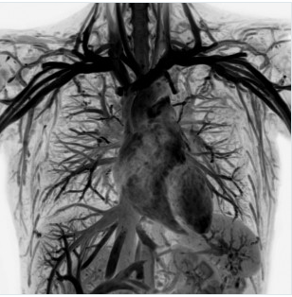
Magnetic Resonance Imaging (MRI)
SHORT FACTS:
MRI systems use a powerful magnetic field and radiofrequency pulses to produce detailed images of the body’s internal structures.
MRI provides high quality images with excellent contrast detail of soft tissue and anatomic structures such as gray and white matter in the brain.
It’s used in a wide range of examinations from brain tumors and inflammation of the spine to slipped discs, assessing blood flow and functioning of the heart.
MRI - Siemens
The principle of MRI.
MRI provides excellent high contrast definition, as shown in this image of the thorax.
How does CT works? https://www.youtube.com/watch?v=E44W54z_Ykw

Slide 12
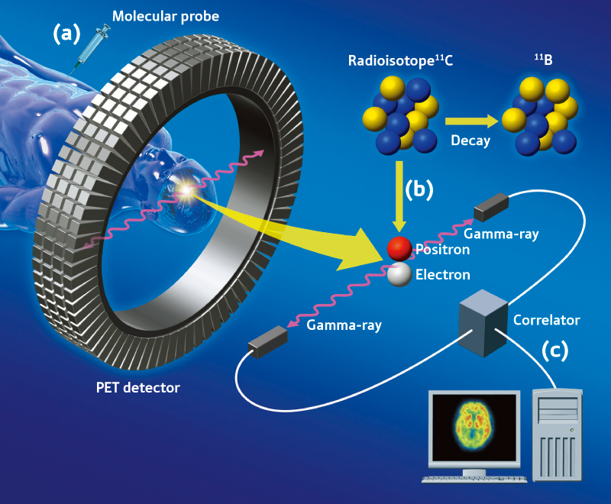
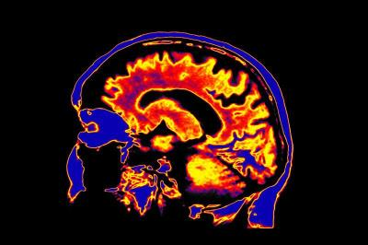
Molecular Imaging
SHORT FACTS:
Molecular imaging is a relatively new discipline that allows the biological processes taking place in the body to be viewed at a cellular and molecular level.
Enables identifying diseases in its earliest stages, well before they would be seen on CT and MR images and would otherwise require invasive surgery.
Used to diagnose brain and bone disorders, cancer, gastrointestinal disorders, heart and kidney diseases, lung and thyroid disorders.
MRI - Siemens
Molecular imaging example.
The principle of Molecular imaging.
How does MI work? https://www.youtube.com/watch?v=y2oZyGe_Kh0

