Slide 1
WORLD CLASS DIGITAL X-RAY SYSTEMS
Introduction – OEM partners
Notes:
Strength of Arcoma as OEM manufacturer for past 25 years > list down all brands and product nameGlobal map of installations to-date – use bubble chart on a global mapTimeline showcase of how Arcoma’s technology has evolved through the yearsHighlight our 1st -in-class technology eg. Auto-positioning
Our cost-effectiveness (not cheapest but cost-effective)Talk about Total Cost of ownership
Our design are modular (verify with RnD) > post-sales service only require replacement of parts and not whole system
A high-level service break-down rate, relatively low > get estimated % from Jonas
Distributors gets revenue & margin from post-sales warranty
Highlight our latest i5 launch > show continuous improvement capability to suit marketsSome photos of Arcoma new production & office facility > we take pride in strict adherence to production and qualityCustomer testimonials and photos

Slide 2
TRUSTED OEM PARTNER FOR
MORE THAN 30 YEARS
Arcoma has been a trusted OEM partner for the past 30 years by leading image diagnostics companies worldwide.
(Aceso, Aceso+, Omnera 400T, Omnera 400A)
(Aristo FX)
D-EVO Suite
Aero X70, Aero X90
Notes:
Over the last 30 years we have worked with companies known to have an extensive imaging portfolio.
They have approached Arcoma and eventually selected arcoma over other OEMs as they wanted a qualitity product with durability that can really help customers and ultimately help in their brand awareness.
It worthy to mention that despite these companies can extensive RND resoucres, they still decided to partner with Arcoma as they feel that Arcoma is the expert of subject when it comes to Full Digital Radiolgy

Slide 3
OEM Partners TODAY
Arcoma cooperate today with two OEM partners. Canon and Konica Minolta. Konica Minolta became our OEM partner in 2019.

Slide 4
Canon Overview

Slide 5
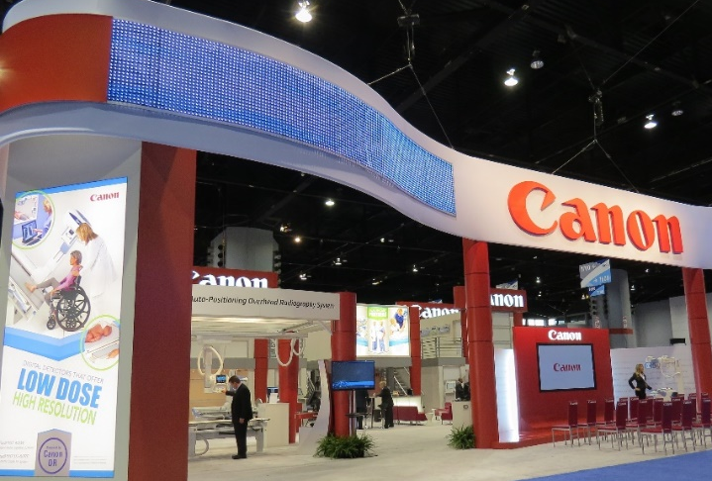
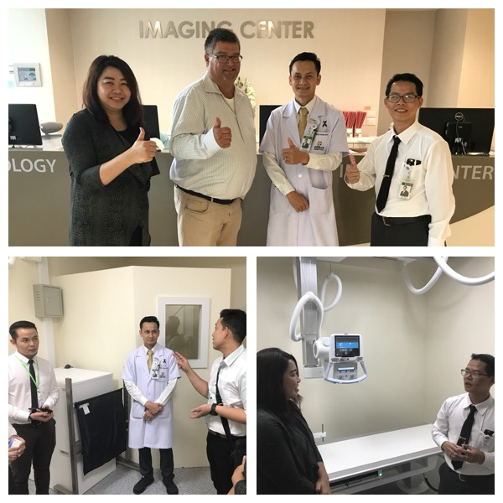
ARCOMA – Canon - A successful partnership
End of 1990 First DR installation Arcoma - Canon in Sweden.
2000 -2005 Combination; Canon DR and Arcoma auto-positioning is a pioneer on the market.
2005- Market share in Nordic countries ~70%. Canon - Arcoma system in the Canon booth at ECR.
2014 Canon US signs agreement with Arcoma.
2014- Canon-Arcoma system in the Canon booth at RSNA.
2016 All available tenders in Hong Kong won by Arcoma – Canon Singapore.

Slide 6
Canon Overview
CANON GROUP (JAPAN)
CANON MEDICAL SYSTEMS COORPORATION (JAPAN)
CANON INC. (JAPAN)
CANON MEDICAL SYSTEMS EUROPE (NETHERLANDS)
CANON MEDICAL SYSTEMS USA
CANON MEDICAL SYSTEMS CANADA
CANON MEDICAL SYSTEMS TURKEY
CANON ENV/COMPONENTS
MEDICAL COMPONENTS BUSINESS GROUP (NETHERLANDS)
CANON SINGAPORE
Medical Equipment Products Division (SINGAPORE)
”Sales companies” we sell our systems through these companies.
”part providers” we buy parts from to our systems.
Notes:
Canon Inc är ”ur Canon” som tillverkar detektorer. De är leverantör till oss för detektorer och andra komponenter kopplade till bildsystemet.
CMS är Toshiba Medical System som Canon förvärvade. CMS är vår kund som köper hela system av oss och säljer dem till slutkunder.

Slide 7
Konica Minolta overview

Slide 8
Konica Minolta
SHORT FACTS:
Konica Minolta has been active in Healthcare for a long time and has been active in this field since 2010 with it’s state of the art AeroDR product family.
Konica Minolta’s Healthcare division in Europe is part of Konica Minolta Business Solutions Europe with headquarters in Langenhagen (Hannover, Germany), and Amsterdam, the Netherlands.
Konica Minolta Europe is expanding it’s portfolio in X-ray and Healthcare-IT.

Slide 9
Arcoma – Konica Minolta
Aug 2019 – Arcoma initiates development cooperation with Konica Minolta Europe
Konica Minolta and Arcoma began a collaboration regarding the development of two new products. The products are based on Arcoma's product platform and technology and integrate Konica Minolta's detectors and software for image processing and image management.
May 2020 – Konica Minolta Europa signs 5-year supplier agreement with Arcoma

Slide 10
Products

Slide 11
Product names
Arcoma Distributors | Canon Europe | Canon USA and Canada | Konica Minolta
Arcoma Precision i5 | Aceso+ | Omnera 400A | Aero DR X90
Arcoma Intuition | Aceso | Omnera 400T | Aero DR X70

Slide 12
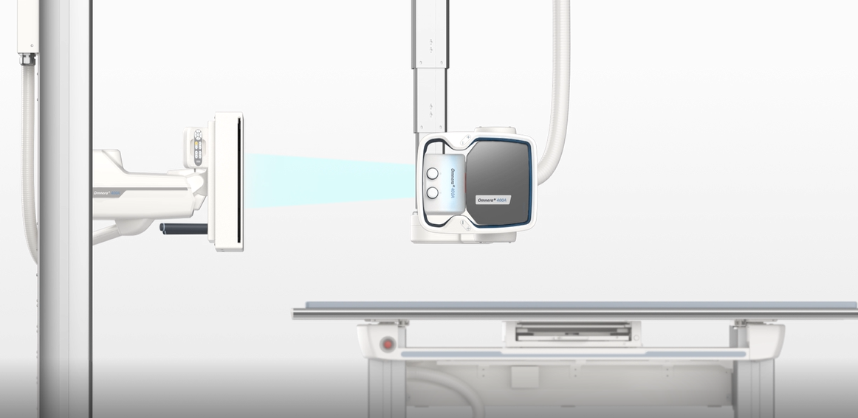
Product branding
The products can be branded with OEM partner logotype on specific areas. Examples in image.

Slide 13
Sales

Slide 14
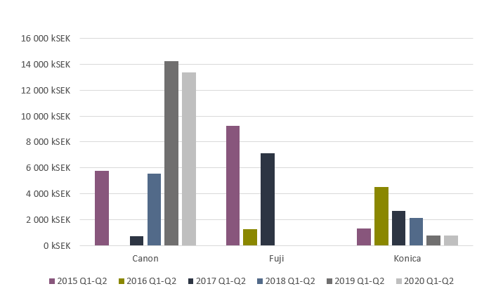
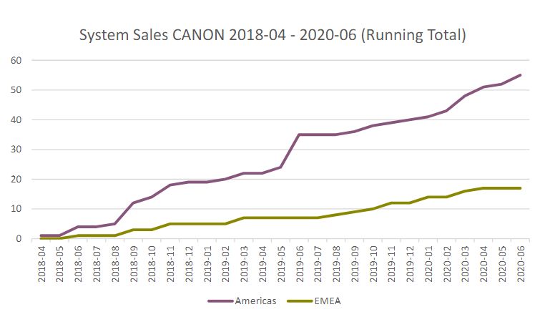
Sales – OEM

Slide 15
THANK YOU
Arcoma AB | Annavägen 1 | 352 46 Växjö | Sweden
PHONE
EMAIL
WEBSITE
+46 470 70 69 00
service@arcoma.se
www.arcoma.se
Notes:
Add take away

