Slide 1
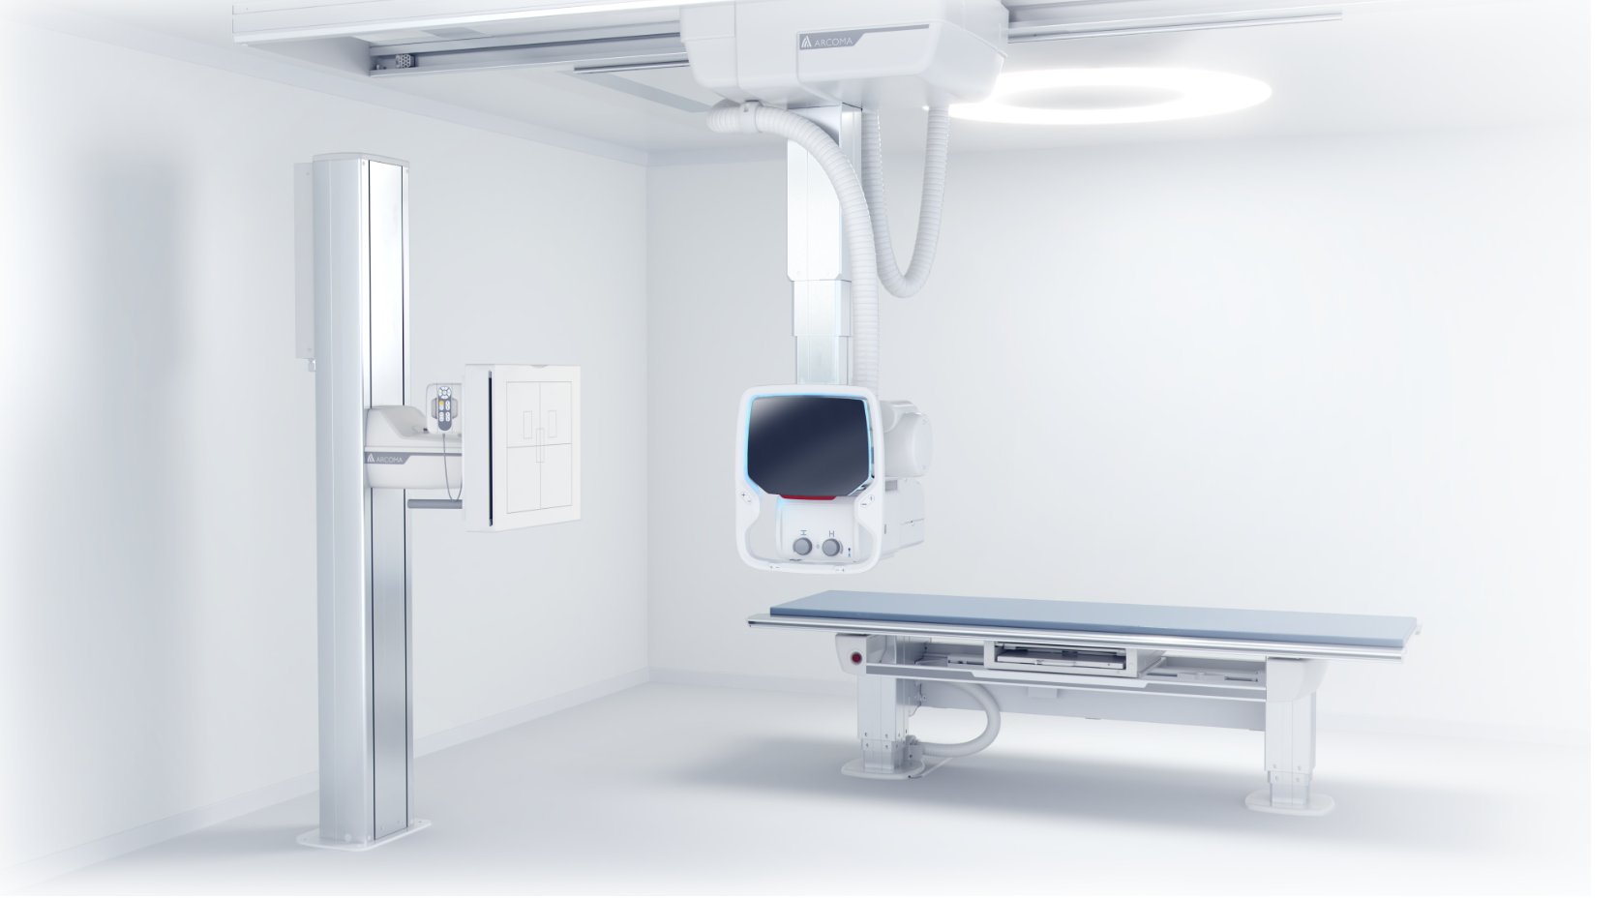
EXTENDED WALL STAND
ARCOMA PRECISION i5
EXTENDED WALLSTAND
This new option improves the workflow, makes the examination more efficient and much more comfortable for the patient. The extended length between the column and the wall stand detector allows easier examinations of the patients on a stretcher. Instead of transferring a Patient to the examination table the Patient can remain on the stretcher.
Extended length between the column and the Wall stand detector. Allows easier examinations of the patients on a stretcher. > new option

Slide 2
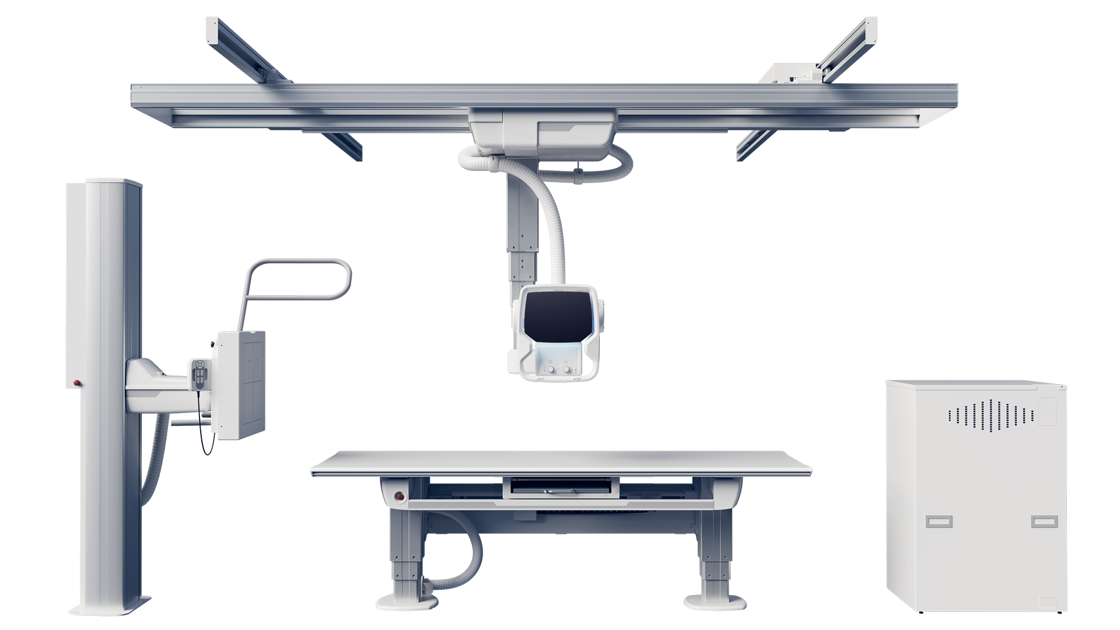
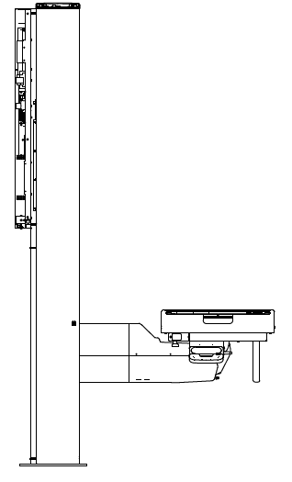
EXTENDED WALL STAND
ARCOMA PRECISION i5
Flexible workflow
Convenient for patient
EXTENDED LENGTH
STANDARD LENGTH
Notes:
Easy to use interface
Quick start-up
Auto positioning
Excellent fine tuning
Easy access for patients
Easy stitching

Slide 3
EXTENDED WALLSTAND
ARCOMA PRECISION i5
BRIEF DESCRIPTION
The extended Wall stand will give a longer distance between WS column and detector center.
CLINICAL VALUE
The longer distance will give access to position a stretcher above a titled WS detector. Instead of transferring a Patient to the examination table the Patient can remain on the stretcher.

