Slide 1
PRODUCT PRESENTATION Arcoma Intuition

Slide 2
CONTENT
Arcoma Intuition
Arcoma Intuition
Arcoma X-ray Cube
Stitching
Resus room application

Slide 3
ARCOMA INTUITION

Slide 4
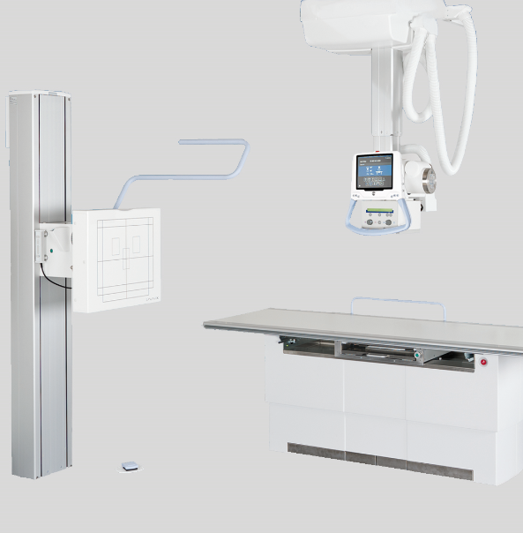
OUR PRODUCT LINES
ARCOMA INTUITION
VERSATILE DIGITAL RADIOGRAPHY SYSTEM
Arcoma Intuition is a versatile digital radiography system that combines outstanding image quality with clinical flexibility and high productivity for a wide range of radiographic applications. The cost-effective, modular concept allows you to configure the system to precisely fit your room and clinical requirements.
Note: the system is equipped with options and accessories
Notes:
To change the image behind the Mock up.
Select the layer - > Right Click -> Send to Back -> Delete the image -> Drag & Drop your Own Picture -> Send to Back (again)

Slide 5
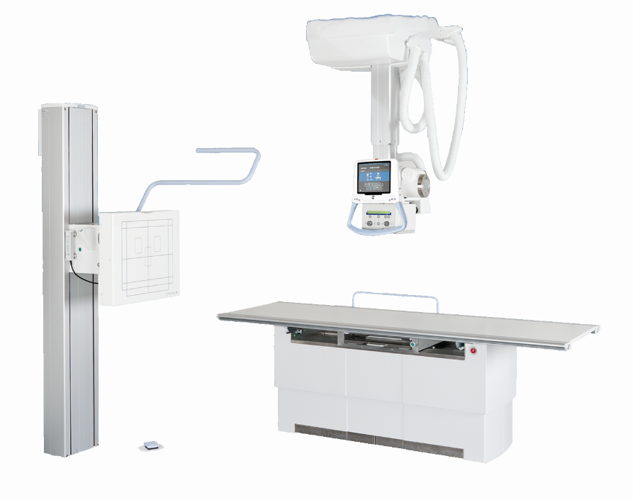
Low dose
Excellent imaging results
Smart investment
Shared detector configurations
Easy workflow
ARCOMA INTUITION
Ergonomic design
VERSATILE DIGITAL RADIOGRAPHY SYSTEM
Note: the system is equipped with options and accessories
Notes:
To change the image behind the Mock up.
Select the layer - > Right Click -> Send to Back -> Delete the image -> Drag & Drop your Own Picture -> Send to Back (again)

Slide 6
THE INTUITION X-RAY SYSTEM

Slide 7
Arcoma Intuition
The Arcoma Intuition system can be ordered with either open or closed table.

Slide 8
X-Ray Tube
Lightweight Overhead Tube Crane
Easy to position with full manual override
Manoeuver to the precise position required
Lower risk of back and shoulder injury
Can be installed into rooms with weaker ceiling structures
Intuitive on-tube touch screen
Verify patient identity
Change exposure factors
Image review for positioning assistance
Fully motorised auto positioning and servo tracking
Notes:
Full manual override, glides smoothly to an exact position. No juddering and bumpy movements
Lighter OTC means lower ceiling structure requirements

Slide 9
Vertical Wall Stand
Lightweight manual and motorised vertical movement
OTC servo tracking
Multiple centre points allow optimum positioning
Easily-removable grid
Quickly rotates to horizontal position
Extensive vertical range allows imaging of lower extremities
Facilitates paediatric imaging
Integrated collimator control
Long film imaging with automatic stitching
Notes:
Horizontal Position is ideal for Hand/Wrist X-rays where the patient can remain standing comfortably
Counter-balanced to make manual vertical movement smooth and effortless
Extensive Range makes imaging tall or paediatric patients easy

Slide 10
Radiographic Table – Open table
Open table design
Optimises patient access
Better infection control
Large tabletop with long and effortless table stroke
X-ray from skull to toe without moving the patient
Automatic table tracking keeps the OTC at a pre-defined SID
Long table release bar is easily accessible
Low table position for ease of patient transfer
High weight limit of 300kg
Tableside and foot pedal controls for table height
Notes:
Movable foot pedals mean wheelchairs/stretchers can be brought ride up to the side of the table

Slide 11
Radiographic Table – Closed table
Optional closed table for Intuition system
Ideal for uneven floors
Large tabletop with long and effortless table stroke
Automatic vertical tracking keeps the OTC at a pre-defined FFD
Low table position for ease of patient transfer
High weight limit of 295kg
Tableside hand controls
Inline foot pedals
Notes:
For installations where the floor may not be perfectly level
Cost-effecitve option
Features the same, smooth gliding table top as Open Table

Slide 12
X-RAY CUBE - ARCOMA INTUITION

Slide 13
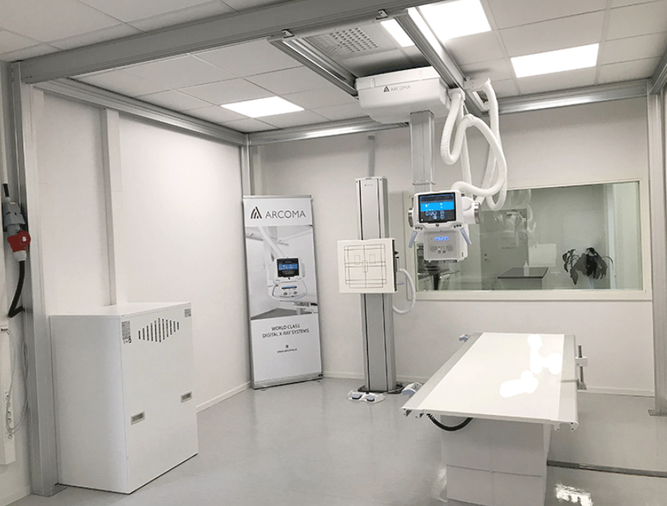
Arcoma X-ray Cube
The Arcoma X-ray Cube is a standalone self-supporting solution that enables quick installation of an X-ray system in, for example a temporary hospitals.
Set-up of this system can be done in less than 24 hours and it´s also quick to take down or move when the needs change.
Can be used together with the Arcoma Intuition system

Slide 14
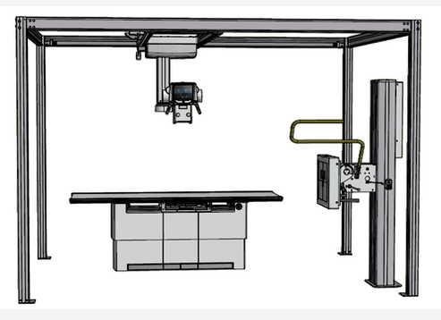
Cube installation
Self-supporting
Quick installation (less than 24 hours)
Perfect for temporary needs
Details:
Optional for Intuition System
No ceiling support required
Two heights available
2.5m (8’ 3”)
2.8m (9’ 3”)
Still allows FFD of 115cm
Gives the flexibility of an overhead tube without needing ceiling strength

Slide 15
STITCHING - ARCOMA INTUITION

Slide 16
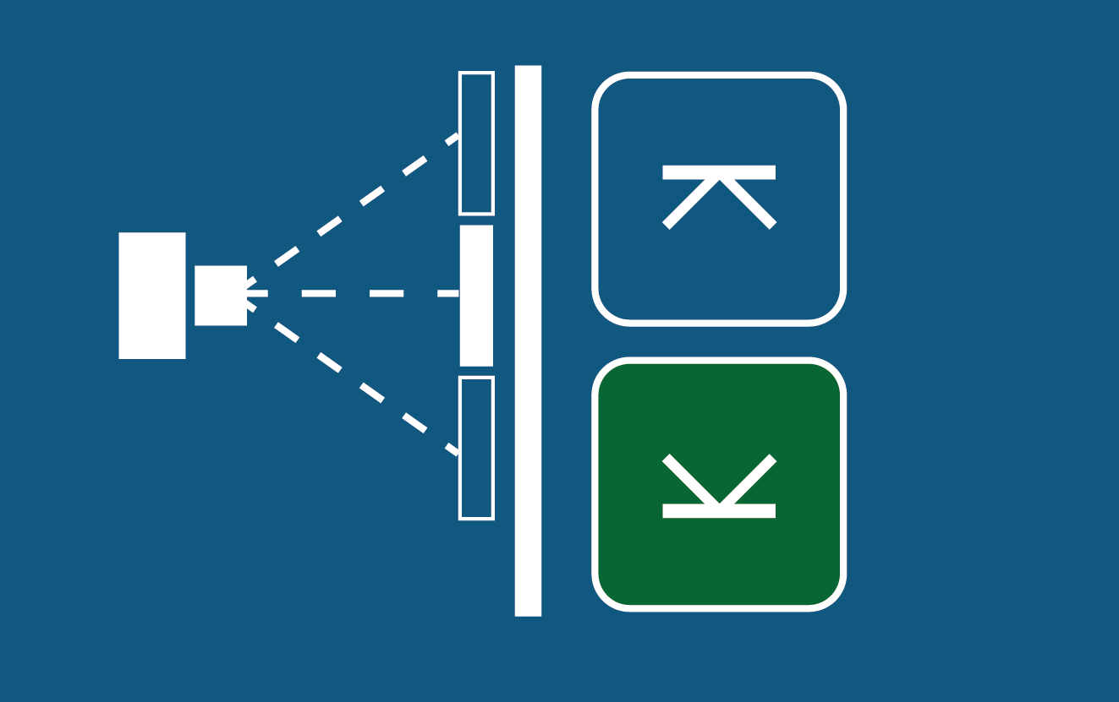
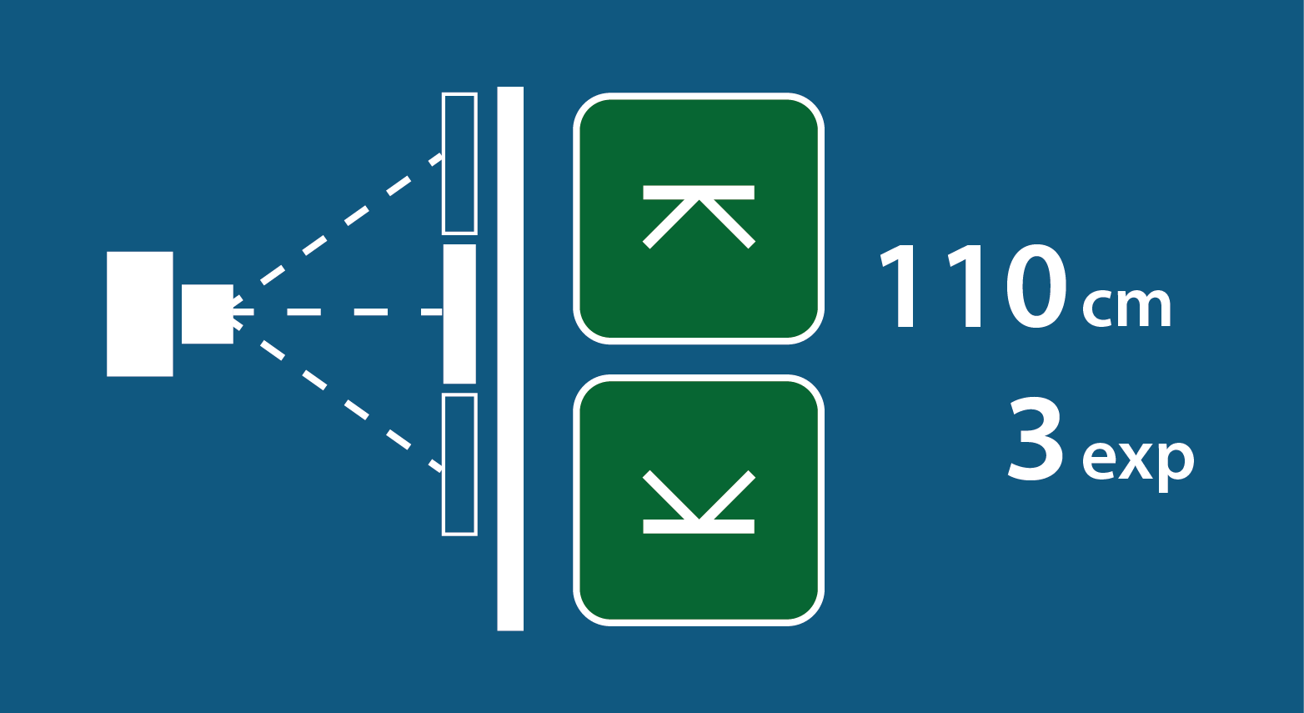
Intuition, stitching procedure
1) Indicate the lower limit *) of the image by adjusting the collimator light.
Define by selecting the button on the OTC display.
2) Indicate the upper limit *) of the image by adjusting the collimator light. Define by selecting the button on the OTC display.
*) Upper or lower limits can be defined in any order.

Slide 17
Intuition, stitching procedure
3) Press exposure handle
4) Images are captured automatically
Image 1
Asymmetric collimator shutter
Asymmetric collimator shutter
Image 2

Slide 18
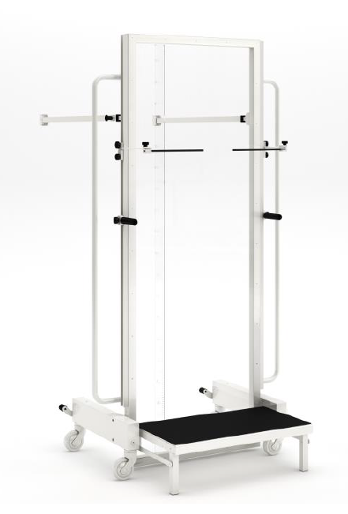
Stitching frame
The stitching frame provides additional patient support in the standing position for multi-exposure stitching.
Mobile
Step, Grip rails
Adjustable patient arm rests
Radiopaque Ruler
Clear Plexiglas backing
Locates into precise position in front of Wall Stand

Slide 19
Resus room application - ARCOMA INTUITION

Slide 20
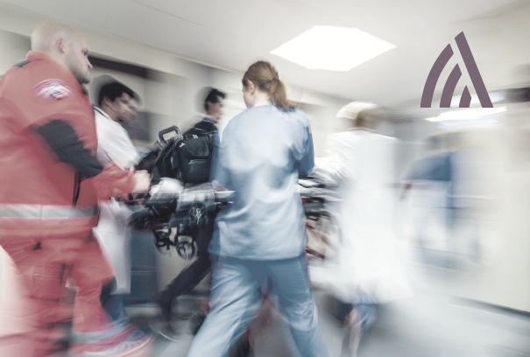
The Resus room
A Resus room is an area for patients who are admitted, often via ambulance, for resuscitation.
A typical general hospital has several fully equipped bays and overhead gantrys for portable emergency X-rays.

Slide 21
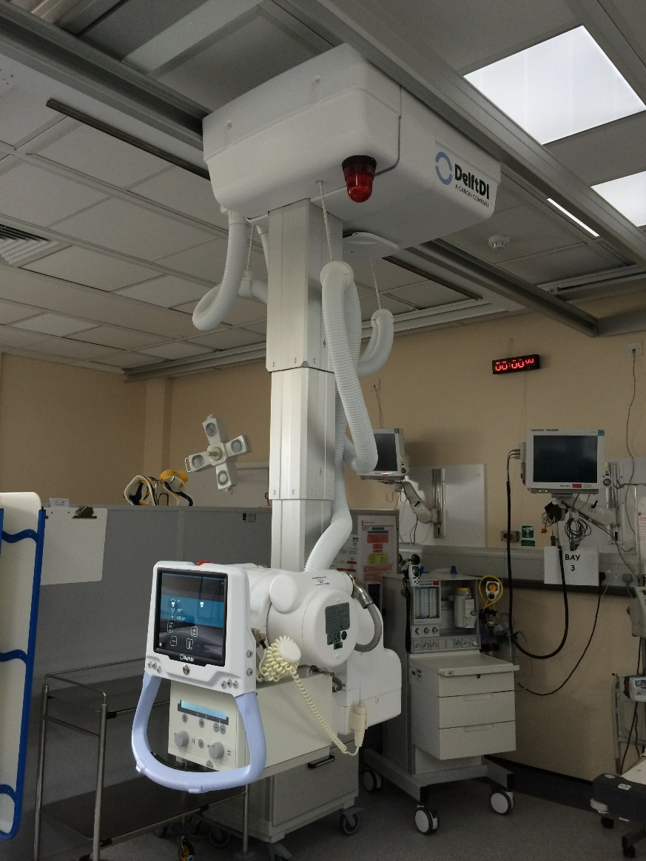
Resus configuration
The Resus configuration for Arcoma Intuition consists of only the OTC (without table and wall stand.)
With an Overhead Tube Crane (OTC) the floor area will be kept as free as possible from obstruction in the busy trauma area.

Slide 22
Ideal for the Resus Room
The light weighted Intuition and Precision i5 systems are ideal for Resuscitation Room applications.
Lightweight OTC - ideal for multi-bay coverage
Keeps floor area around the patient clear
Integrated exposure buttons, warning lights & Wifi
Instant preview images allow quick confirmation of positioning
Quality trauma imaging can be quickly completed
Up to 24m coverage, with motorised movement between bays
Up to 24 m (80 ft) – covering 6 bays
Notes:
The OTC will have a multi-bay coverage adapted for your needs
and conditions in order to create the best workflow and safety. The system is equipped with exposure handle and x-ray light indication near the user. Patient information, exposure parameters and protocol information is presented on the OTC display and are immediately available. A preview image will also be displayed on the OTC display for quick confirmation of correct positioning.

Slide 23
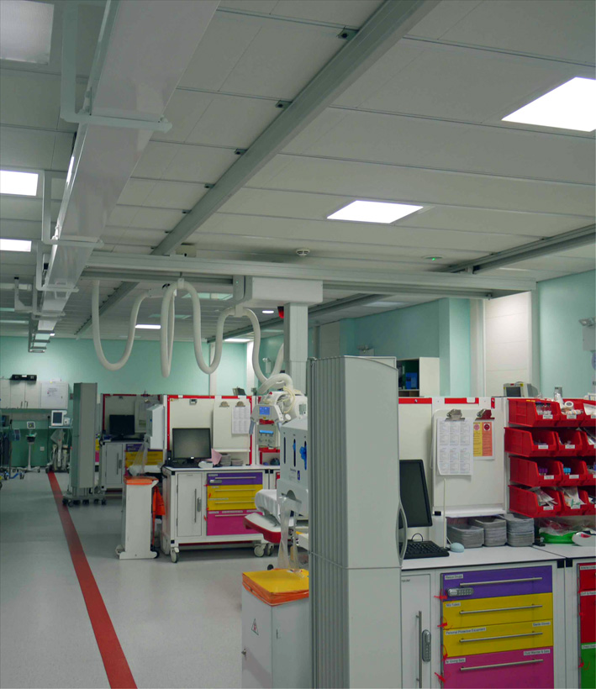
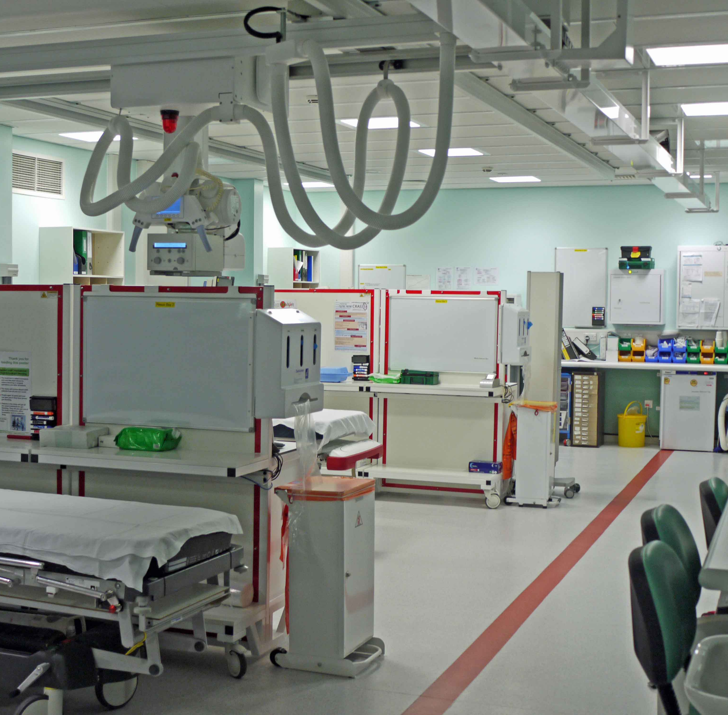
Installations worldwide
Arcoma products has been installed in many resus rooms worldwide, for example at the Royal London Hospital.

Slide 24
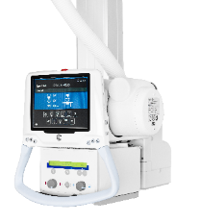
Intuition - Resuscitation Configuration
Resuscitation
3 to 6m
Max 20m

