Slide 1
PRODUCT PRESENTATION Arcoma Precision i5

Slide 2
CONTENT
Arcoma Intuition
Arcoma Precision i5
Stitching
Resus room application

Slide 3
Arcoma Precision i5

Slide 4
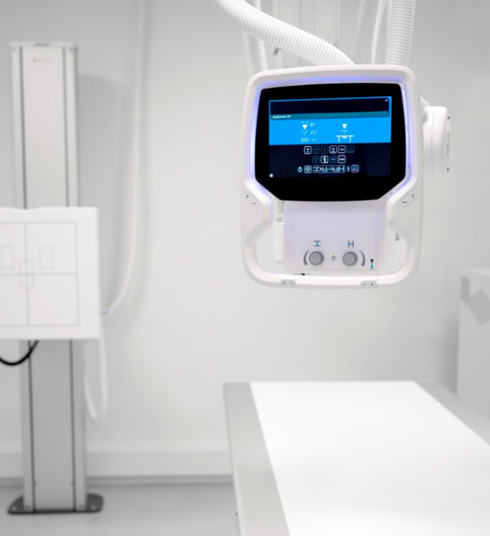
OUR PRODUCT LINES
ARCOMA PRECISION i5
PREMIUM DIGITAL X-RAY SYSTEM
Arcoma Precision i5 is a new premium digital X-ray system that provides high quality images, clinical flexibility and superior workflow.
This is one of the most reliable products on the market, designed and built in Sweden according to the highest quality standards.
The workflow is excellent thanks to state-of-the-art ergonomics and supporting features such as auto positioning, wall stand with motorized tilt and automatic detector tracking.
The manual fine-tuning of the overhead tube crane is unique and can be made with minimal force. Also the ultralight and flexible Canon detectors ensures excellent imaging result at all times with minimal dose.
Notes:
To change the image behind the Mock up.
Select the layer - > Right Click -> Send to Back -> Delete the image -> Drag & Drop your Own Picture -> Send to Back (again)

Slide 5
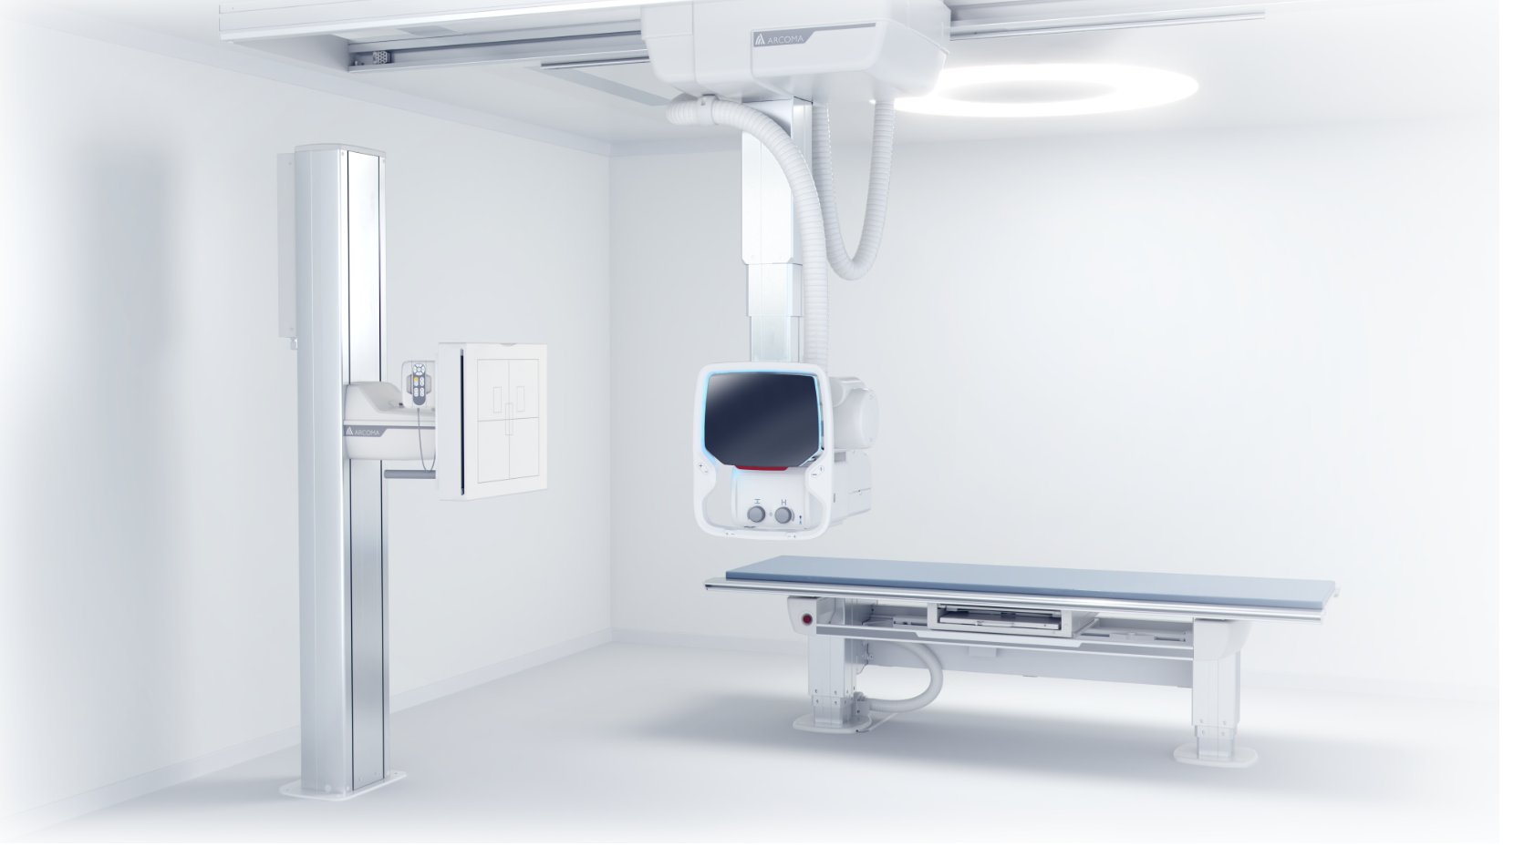
Low dose
Flexible detector configurations
Excellent imaging result
Safe investment
Superior workflow
ARCOMA PRECISION i5
Superior ergonomics
PREMIUM DIGITAL X-RAY SYSTEM
Notes:
The most important benefits of the precision i5.

Slide 6
THE PRECISION i5 X-RAY SYSTEM

Slide 7
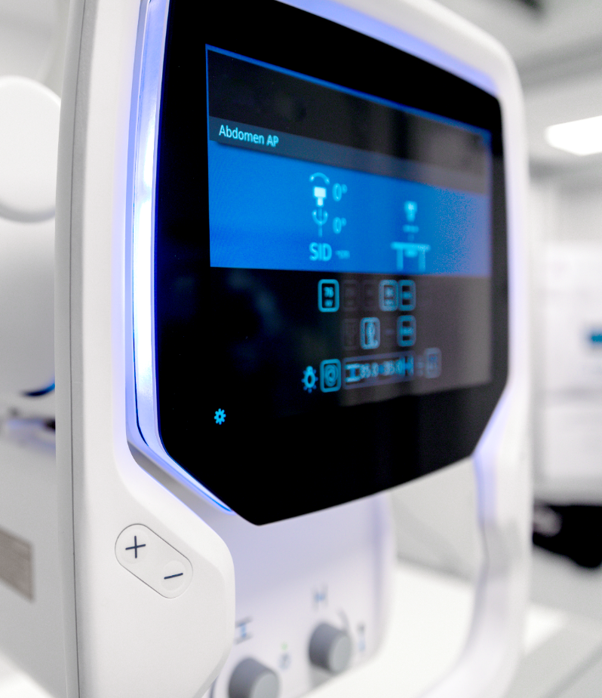
MODERN AND EASY TO USE OTC
EXCELLENT DESIGN
Modern Scandinavian design that blends in nicely into any hospital environment.
EASY DISINFECTION
Easy cleaning and disinfection thanks to glass overlay display with no edges.
SMART AND EASY TO USE Good viewing angle of display and few buttons makes the OTC user-friendly and easy to understand.
Notes:
All system data and configuration on the OTC display (collimator display borttagen och integrerad i OTC)
Improved ergonomics with buttons designed for intuitive use
Backlight ? Vet ej om den kommer att användas för signalering i första release ???
New modern touch display (iPad like interaction) à säg något om det
Bra/bästa betraktningsvinkel av display ???
For later:
Customizable
Possible to customize OTC graphical user interface.
Future SW upgrades will allow personalization and customization of GUI (release schedule not set)

Slide 8
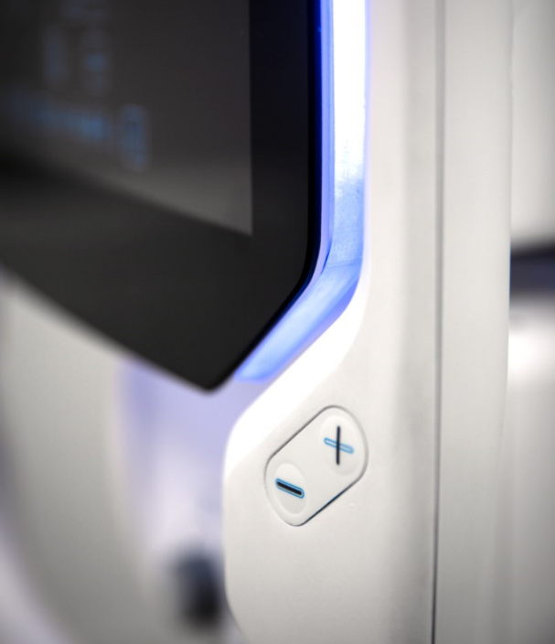
OTC - FEATURES
FEATURES
One of the lightest OTC on the market
Modern user interface
All functions and data in one single workspot
Easy to access buttons
Integrated light indication
All directions movement
Adapted for left- and righthanded
Flexible user interface

Slide 9
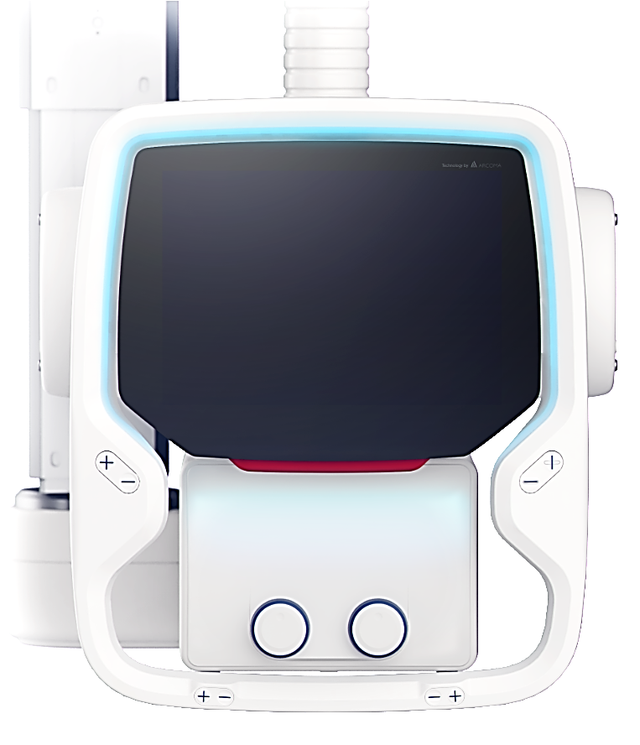
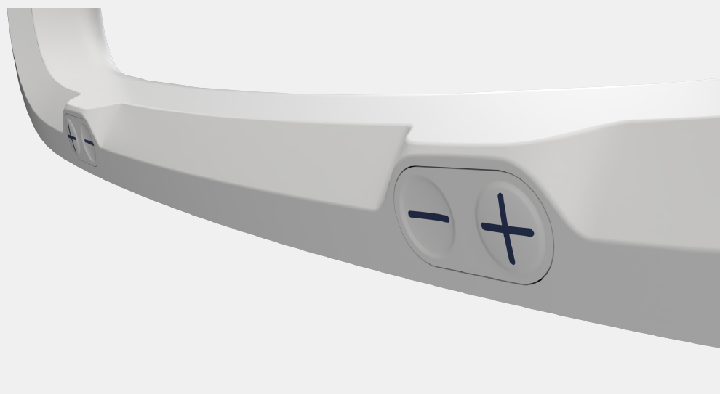
OPERATING THE OTC
FULL INTEGRATION
Patient information
Exposure parameters
Collimator parameters
Light indication
Release all directions (backside)
Release all directions (backside)
Release in all directions - easy movements
Release in one direction
Up / down
Up / down easy accessible for both left- and righthanded
Easy to reach knobs for manual collimator adjustments.

Slide 10
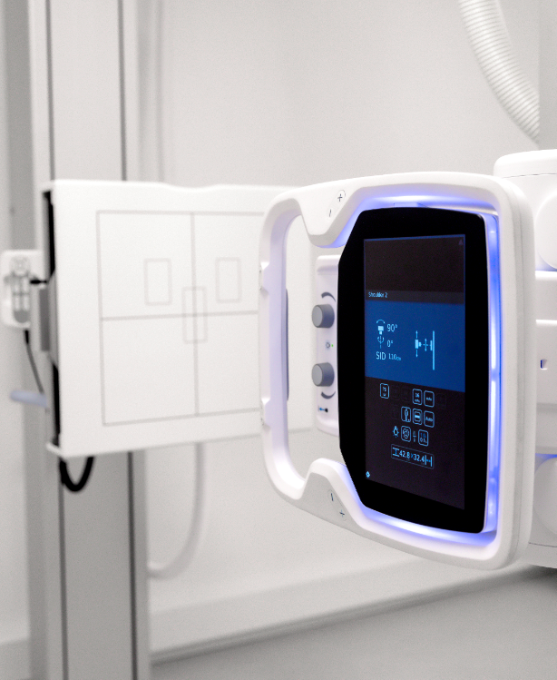
WALL STAND WITH MOTORIZED TILT
OPTIMIZED WORKFLOW
Motorized movements enables efficient examinations
ERGONOMIC DESIGN
Motorized tiltable wall stand allows minimal manual handling.
FULL FOCUS ON THE PATIENT
Easy adjustment and motorized tilt enables increased focus on the patient.
Notes:
Snabbare undersökningar
Effektivare arbetsflöde
Automatiskt pendelmode
Ergonomiskt- tiltad detektor, behöver inte manuellt
Rasterhantering (vill ej lyfta upp än). Kommer när vi uppdaterar bordet.
Tystade än tidigare. Tagit bort fläkten ur systemet. (ny power supply). Phase out.
Business case 4410 – kolla vad linda har skrivit där.
Lättare att ställa in
Ägna mer fokus på patient. Behöver inte höja och sänka detektorvagnen.

Slide 11
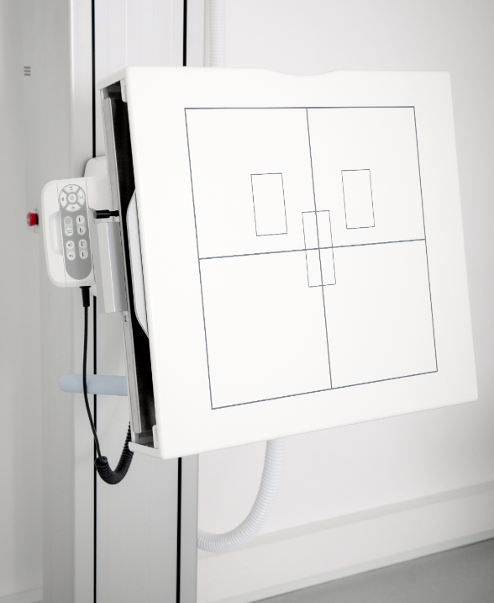
WALL STAND - FEATURES
FEATURES
Motorized tilt of the detector
Motorized and manual vertical movements
Auto tracking (vertical, tilting and pendulum mode)
Hand control for operating wall stand, collimator and auto positioning
Wireless foot controls
Removable lateral arm rest with parking position and adjustable angle
Extended range of vertical movement (Highest and lowest detector position on the market)

Slide 12
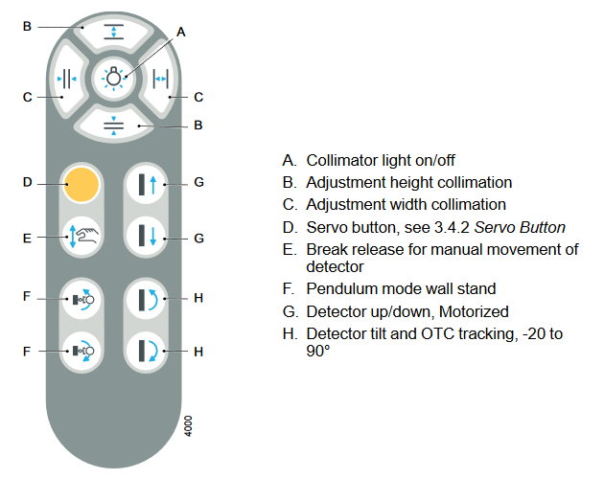
OPERATING THE WALL STAND

Slide 13
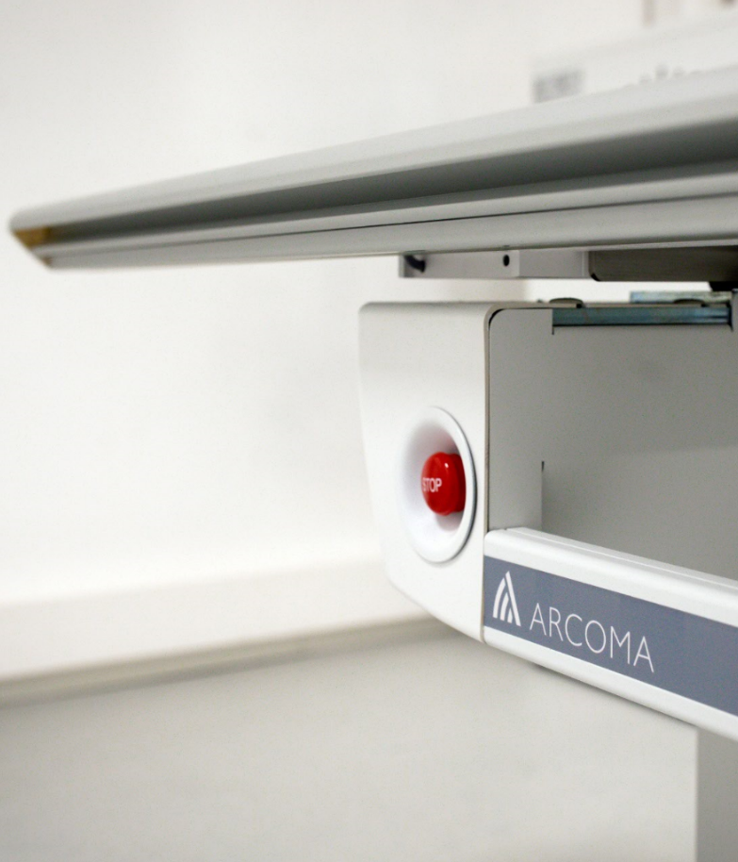
HIGH CAPACITY EXAMINATION TABLE
SMOOTH AND SILENT
Silent and smooth movements thanks to silent brakes and power supplies without fans.
CAPACITY FOR LARGER PATIENTS
Large table top with extension possibility. Patient weight capacity up to 300kg/660lbs.
OPTIMIZED DISINFECTION
Open table design that optimizes patient access and infection disease control.
Notes:
For info! There will be a sound (lower than today) when the brakes are released. I think this is good, it is a nice sound and warns the patient that something is happening - and gives feedback to the user that the brakes are released.

Slide 14
TABLE - FEATURES
FEATURES
Wired and Wireless foot controls (options)
Weight capacity of 300 kg/660 lbs (dynamic)
Large table top with long table stroke
X-ray from skull to toe without moving the patient
OTC automatic tracking table detector
Low position for easy access
Brakes not temperature and humidity sensitive

Slide 15
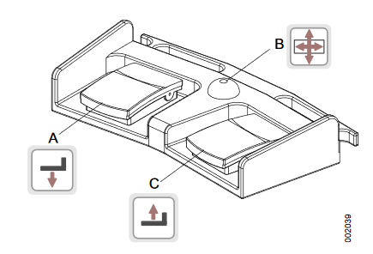
OPERATING THE TABLE
Wired foot control
Wireless foot control
Move table upwards
Table hand grip rail
Table hand control
OTC to left in pendulum mode
Release brakes
OTC to right in pendulum mode
Image receptor holder right
Move table downwards
Image receptor holder left

Slide 16
STITCHING - ARCOMA PRECISION i5

Slide 17
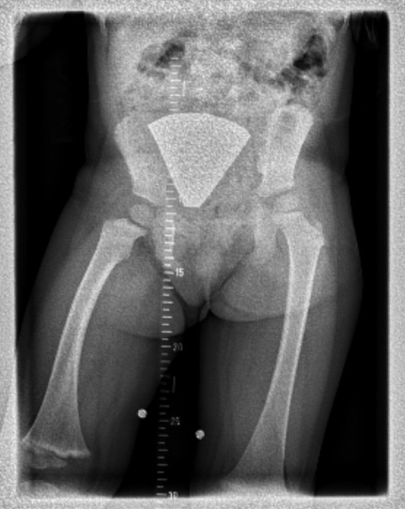
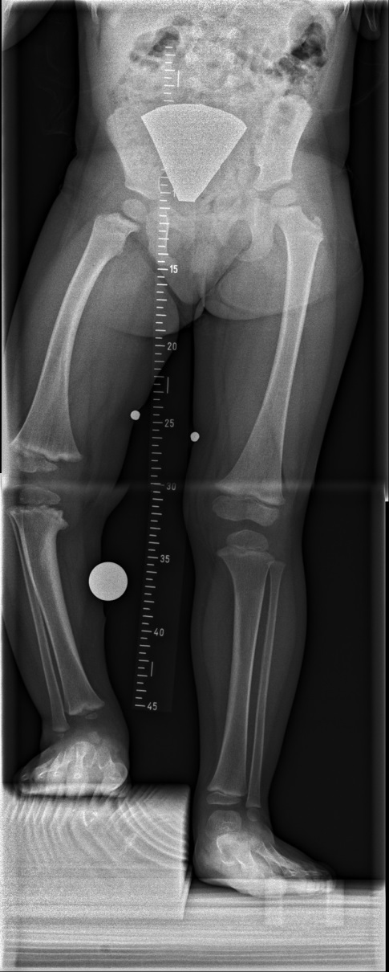
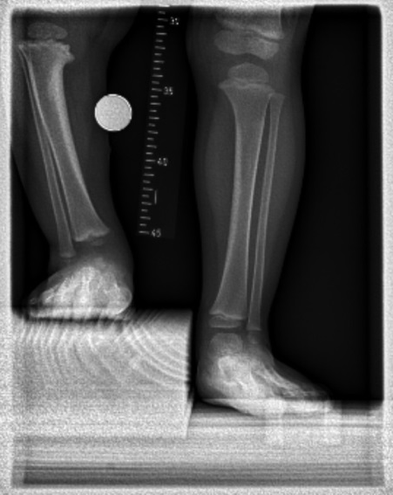
STITCHING
In simple terms, stitching refers to a technique used after the x-rays have been taken, in which multiple x-ray images of a body part are used to create one single, high resolution image. The process of putting them together is referred to as stitching.
By having consecutive images merged together to create an overview, a more comprehensive evaluation of the spine is possible.

Slide 18
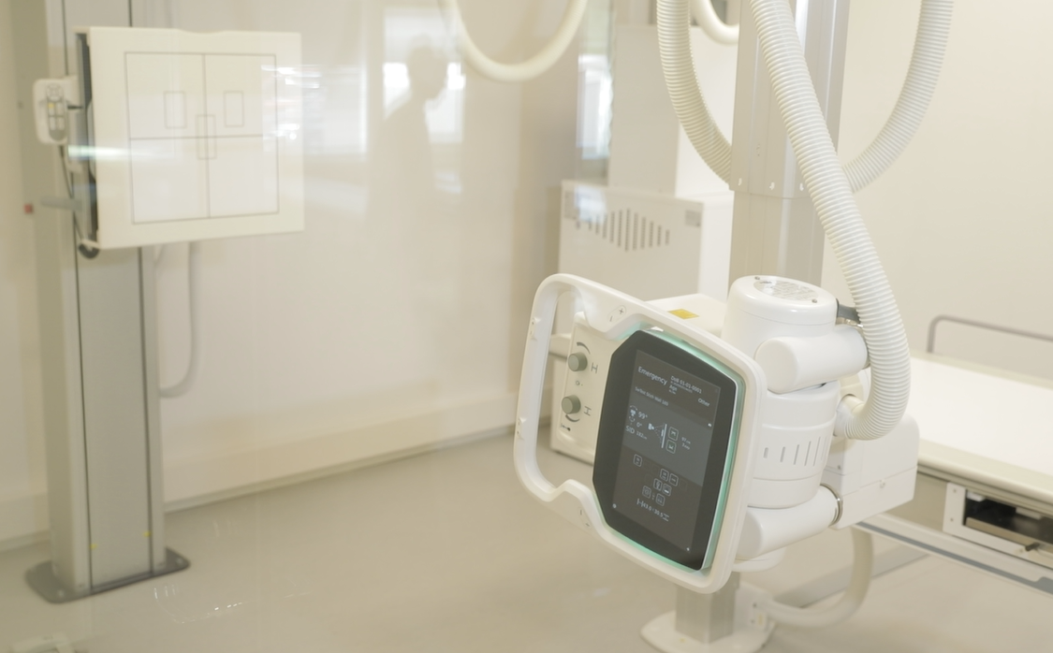
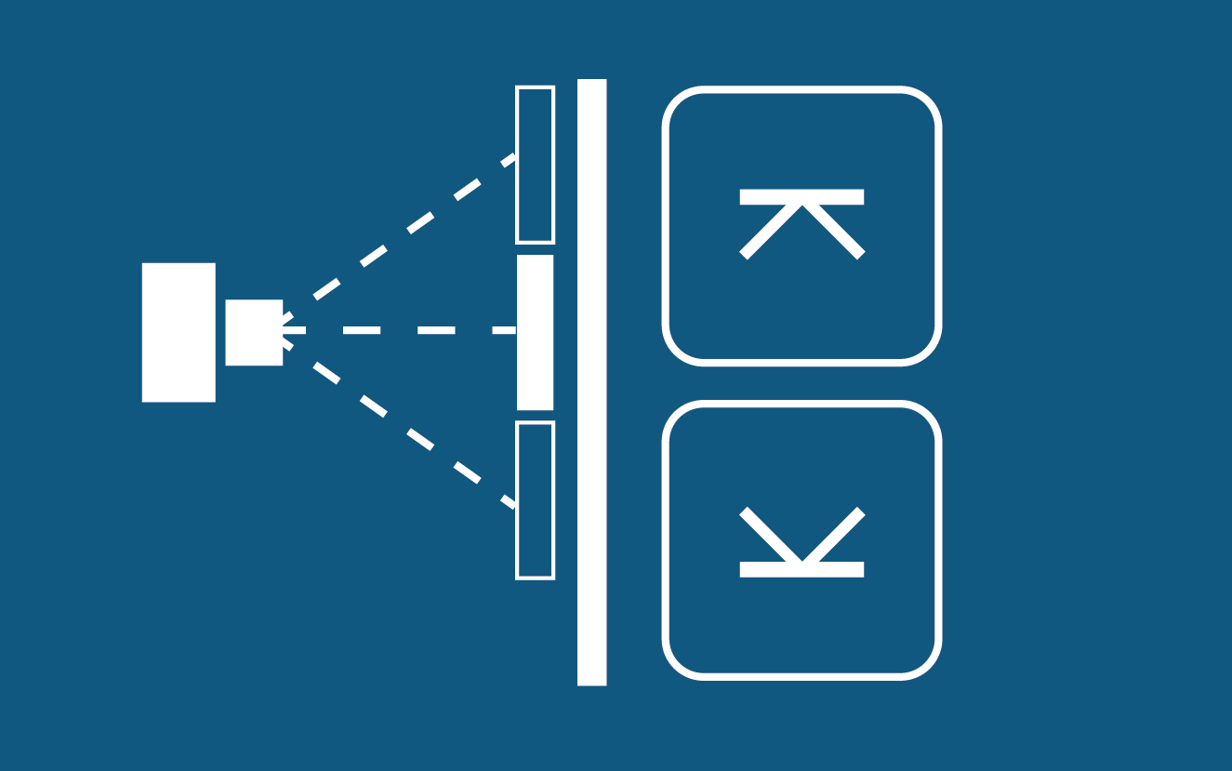
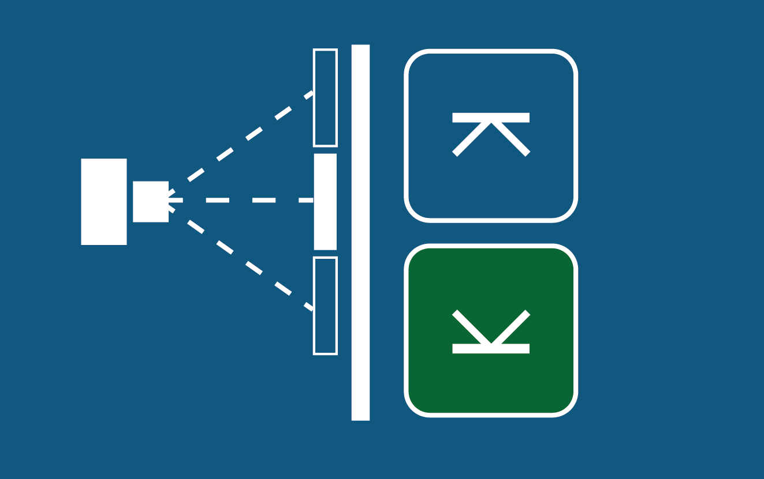
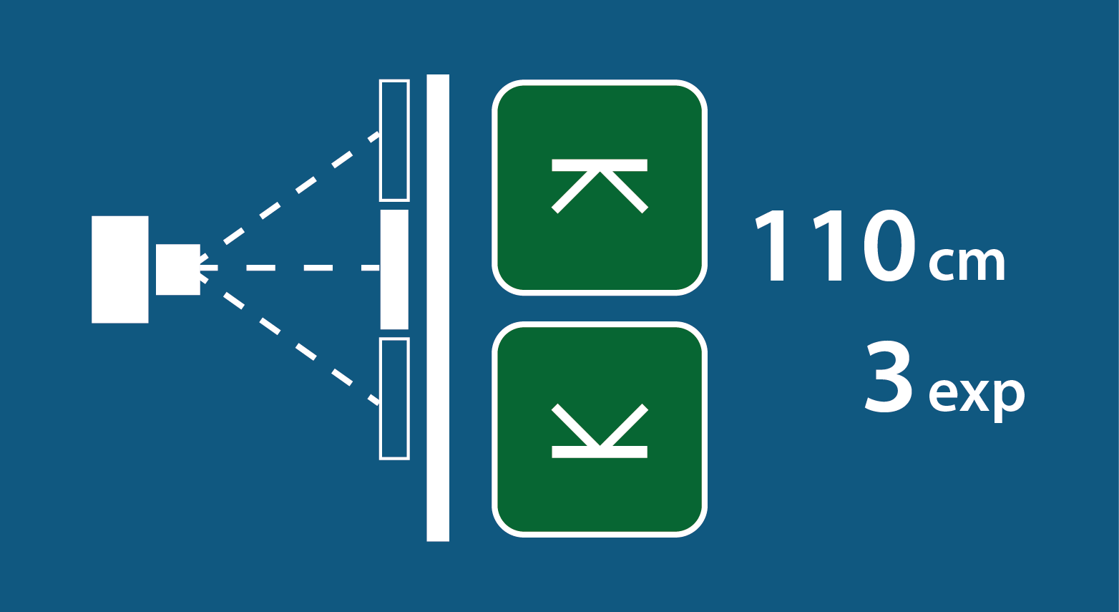
STITCHING STEP-BY-STEP
1
Collimate to the lower border and select the lower arrow key (turns green).
2
Collimate to the upper border and press the upper arrow key (turns green).
3
Length of image and number of images is displayed.
4
Press exposure button. Tube will rotate and detector will move automatically.

Slide 19
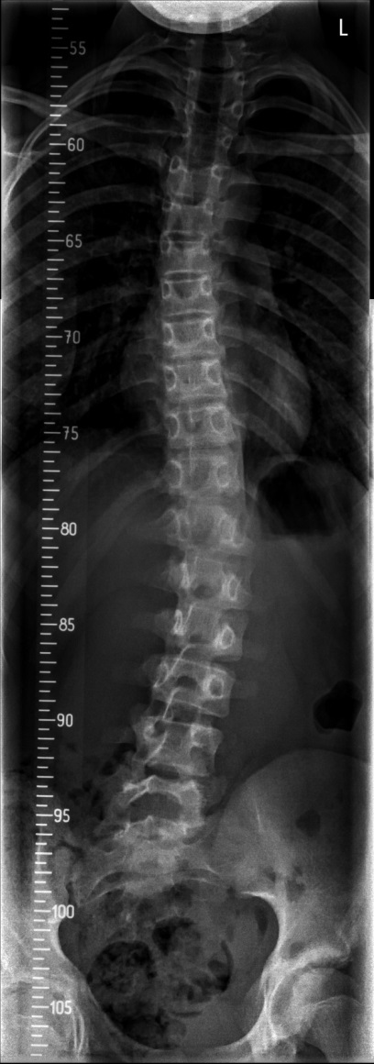
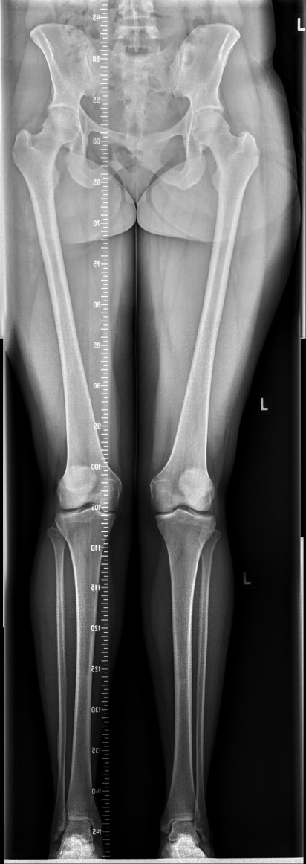
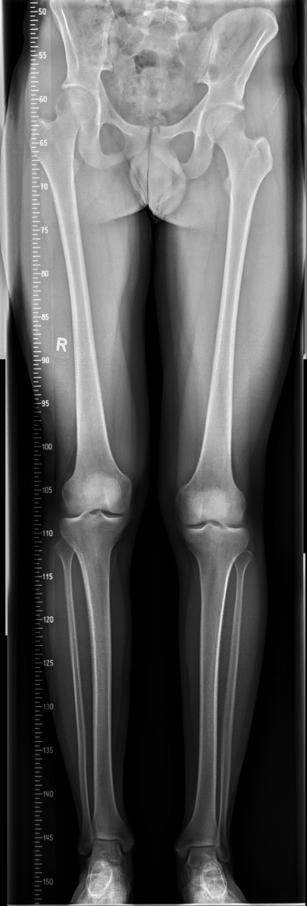
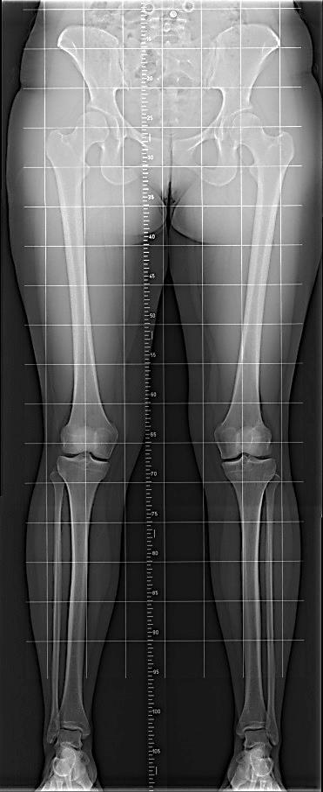
STITCHING
Individual APR Exposures stored e.g. Hip, Knee, Ankle
All individual images + stitched are sent to PACS in DICOM format

Slide 20
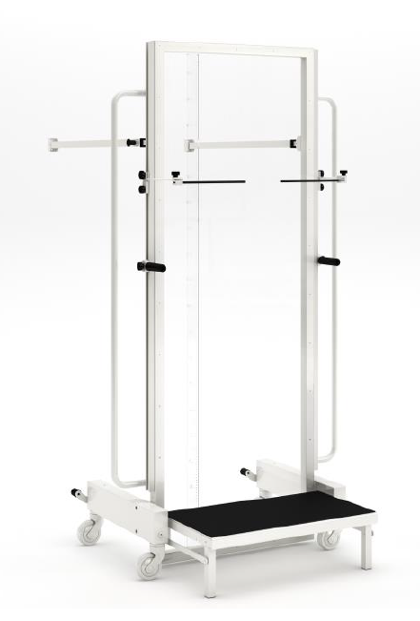
STITCHING FRAME
The stitching frame provides additional patient support in the standing position for multi-exposure stitching.
Mobile
Step, Grip rails
Adjustable patient arm rests
Radiopaque Ruler
Clear Plexiglas backing
Locates into precise position in front of Wall Stand

Slide 21
RESUS ROOM APPLICATION - ARCOMA PRECISION i5

Slide 22
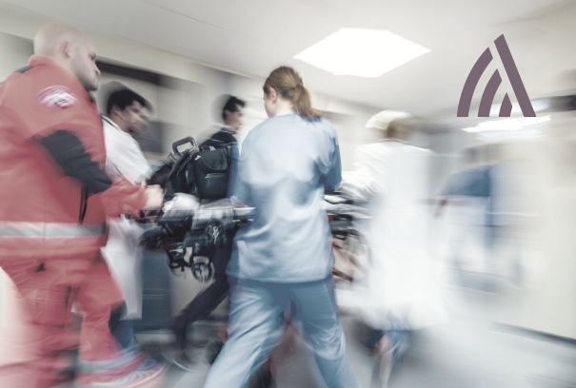
THE RESUS ROOM
A Resus room is an area for patients who are admitted, often via ambulance, for resuscitation.
A typical general hospital has several fully equipped bays and overhead gantrys for portable emergency X-rays.

Slide 23
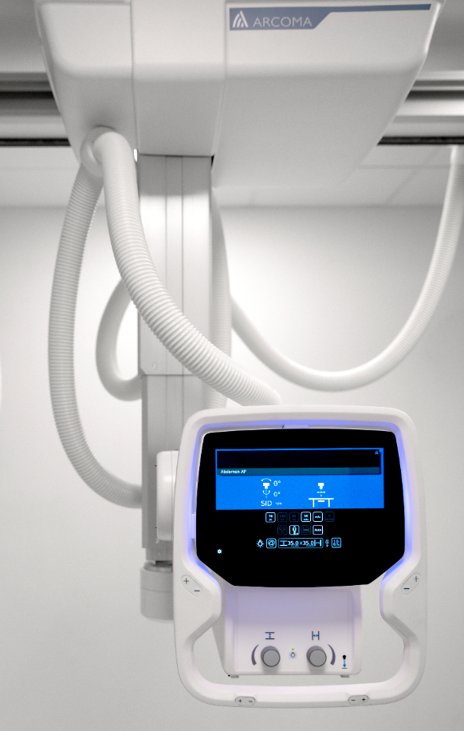
RESUS CONFIGURATION
The Resus configuration for Arcoma Precision i5 consists of only the OTC (without table and wall stand.)
With an Overhead Tube Crane (OTC) the floor area will be kept as free as possible from obstruction in the busy trauma area.

Slide 24
IDEAL FOR THE RESUS ROOM
The light weighted Intuition and Precision i5 systems are ideal for Resuscitation Room applications.
Lightweight OTC - ideal for multi-bay coverage
Keeps floor area around the patient clear
Integrated exposure buttons, warning lights & Wifi
Instant preview images allow quick confirmation of positioning
Quality trauma imaging can be quickly completed
Up to 24m coverage, with motorised movement between bays
Up to 24 m (80 ft) – covering 6 bays
Notes:
The OTC will have a multi-bay coverage adapted for your needs
and conditions in order to create the best workflow and safety. The system is equipped with exposure handle and x-ray light indication near the user. Patient information, exposure parameters and protocol information is presented on the OTC display and are immediately available. A preview image will also be displayed on the OTC display for quick confirmation of correct positioning.

Slide 25
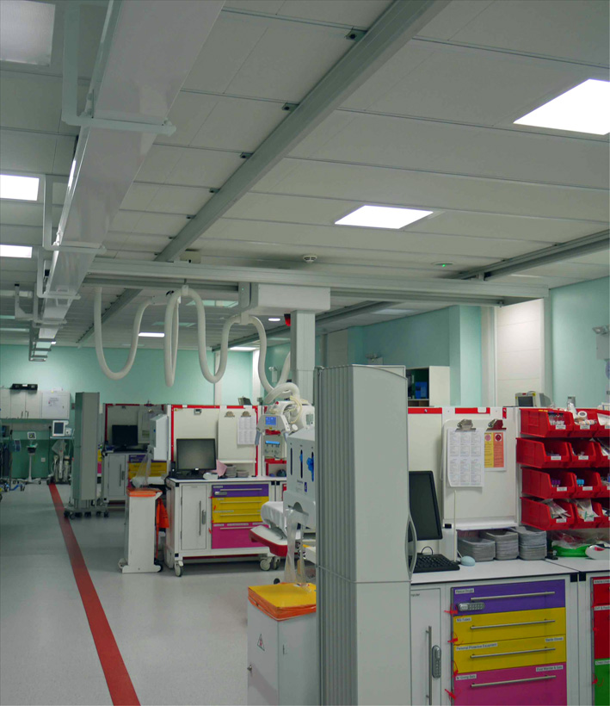
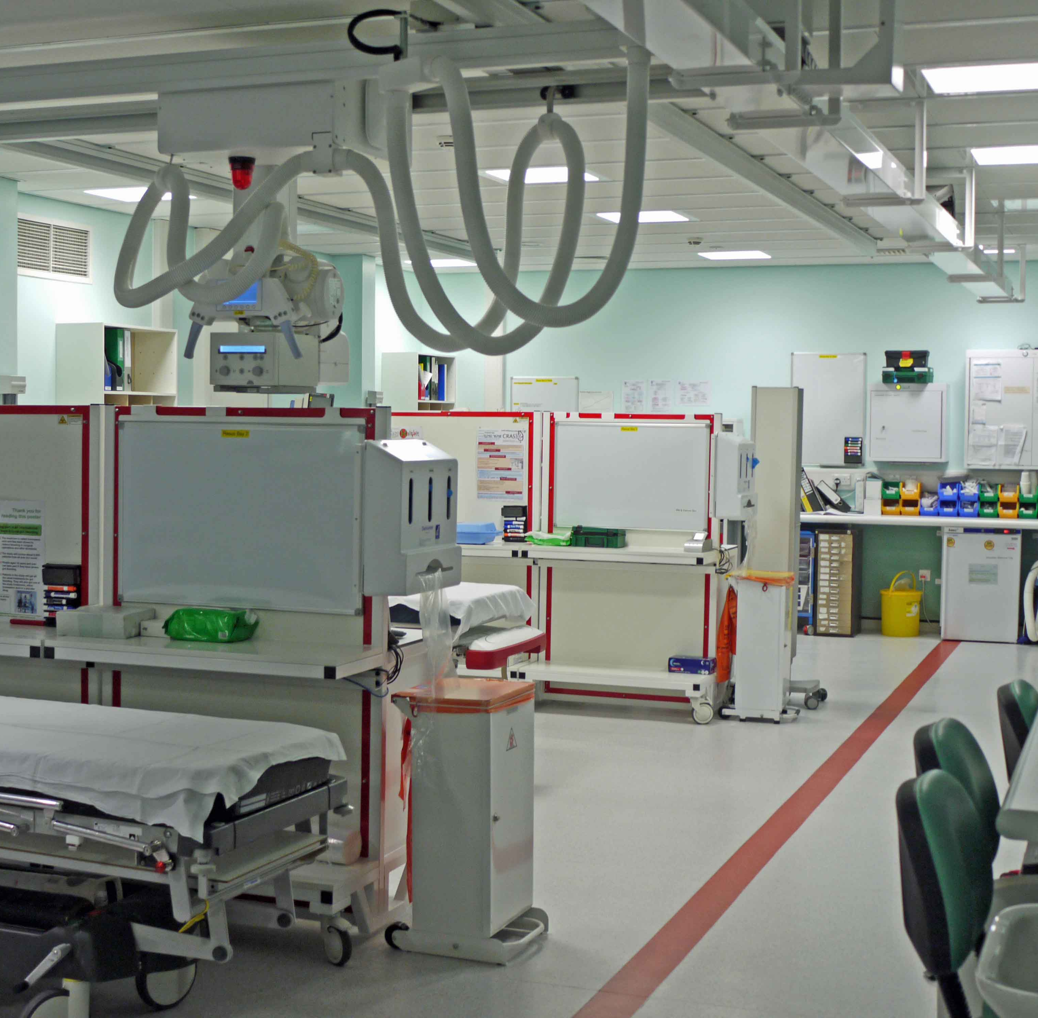
INSTALLATIONS WORLDWIDE
Arcoma products has been installed in many resus rooms worldwide, for example at the Royal London Hospital.

